Slide 1
Cloud and Aerosol size distributions and CCN activity
Sara Lance
WFM Pilot Study, Preliminary Observations
Aug 24, 2017

Slide 2
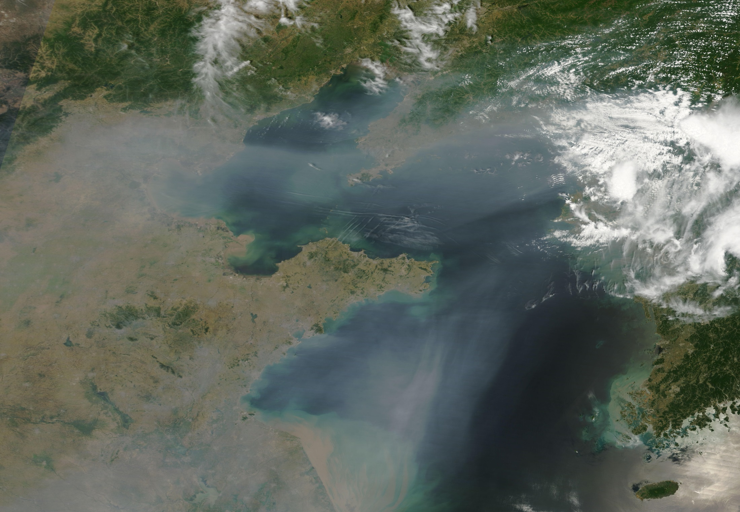
Aerosol Impacts: Climate (‘Global Dimming’)
Haze blown off the Eastern coast of China, over Bo Hai Bay and the Yellow Sea

Slide 3
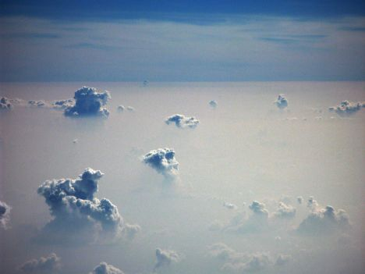
Aerosol Impacts: Climate (Effects on Clouds)
“Indirect Effect” of Aerosols on Climate
More particles that act as “Cloud Condensation Nuclei” = clouds with a higher concentration of droplets

Slide 4
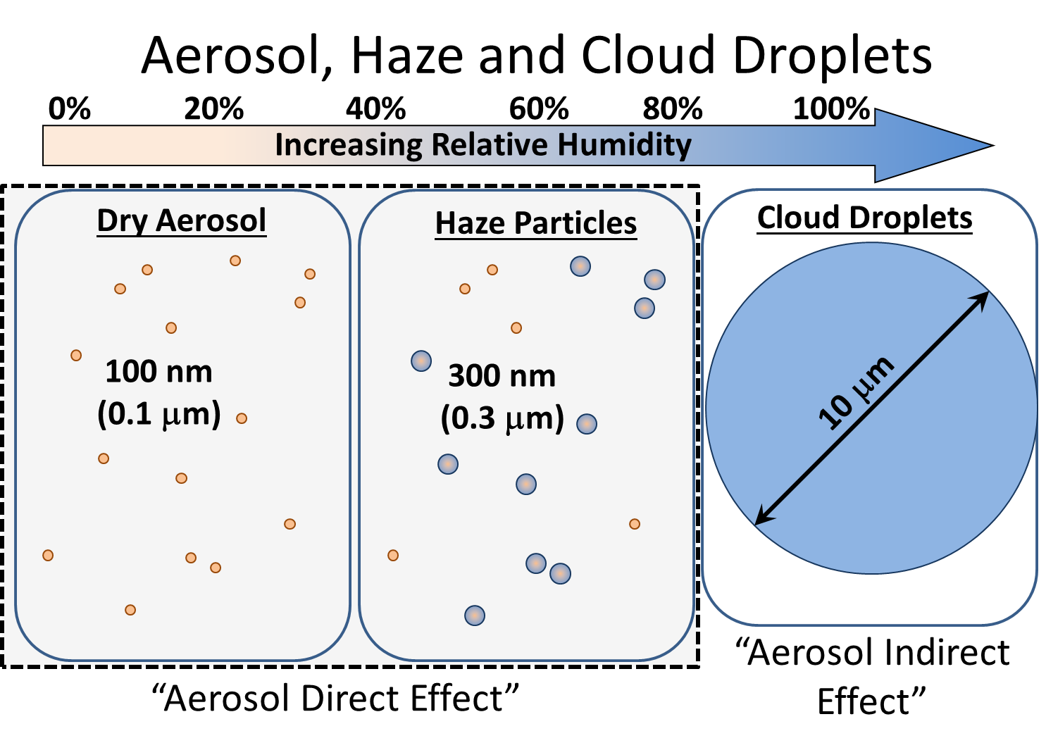
Notes:
Continuum between the aerosol and cloud measurements, since particles do not remain a constant size. Dry aerosol particles grow hygroscopically when exposed to water vapor. At RH < 100% some particles can swell significantly and become haze particles. Above 100% RH, the hygroscopic particles can then ‘activate’ and act as CCN, at which point they grow very quickly through condensation to become cloud droplets, which are typically 10-20 um in diameter.

Slide 5
Summit Measurement Summary
Day |  | Aerosol | CCN | Clouds | Notes
Aug 13 | Sun | Total Number | Total Number | Tail end of am clouds | DMA broken
Aug 14 | Mon | Total Number | Total Number |  | DMA broken
Aug 15 | Tues | Size distribution | Total Number in am | FSSP measurements down from 6-10am | DMA leaking, FSSP connectivity problem
Aug 16 | Wed | Size distribution | size resolved, Calibration
Aug 17 | Thurs | Size distribution | size resolved
Aug 18 | Fri | Size distribution | size resolved
Aug 19 | Sat | Size distribution | size resolved |  | Long cloud sampling day
Aug 20 | Sun | Size distribution | size resolved
Aug 21 | Mon | Size distribution | size resolved, Calibration 10-11:30am |  | Hazy. Clear-air comparison with van
Aug 22 | Tues | Size distribution | size resolved
Aug 23 | Wed | Size distribution | size resolved

Slide 6
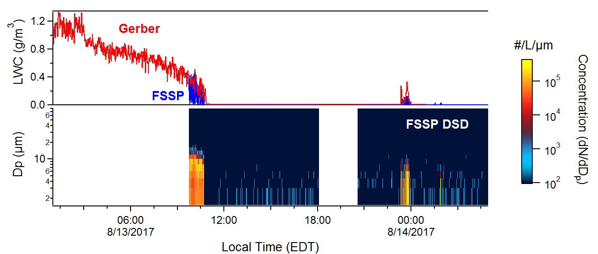

Slide 7
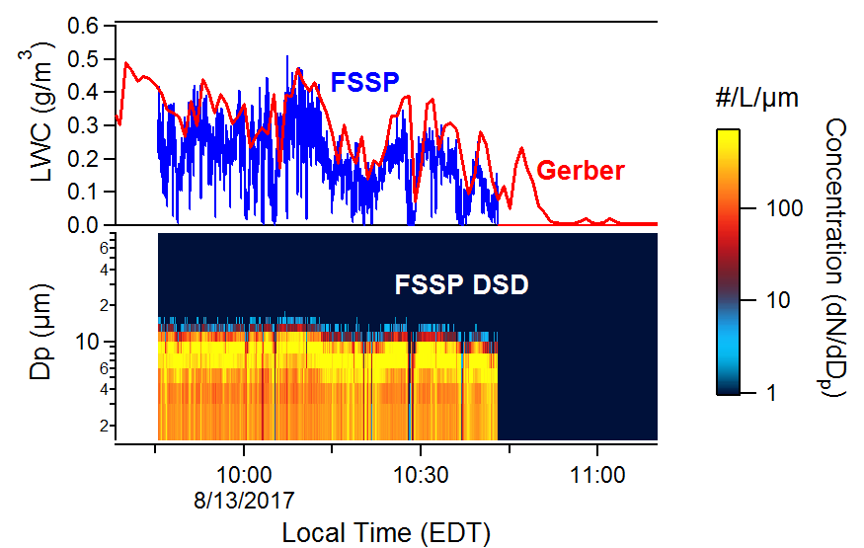

Slide 8
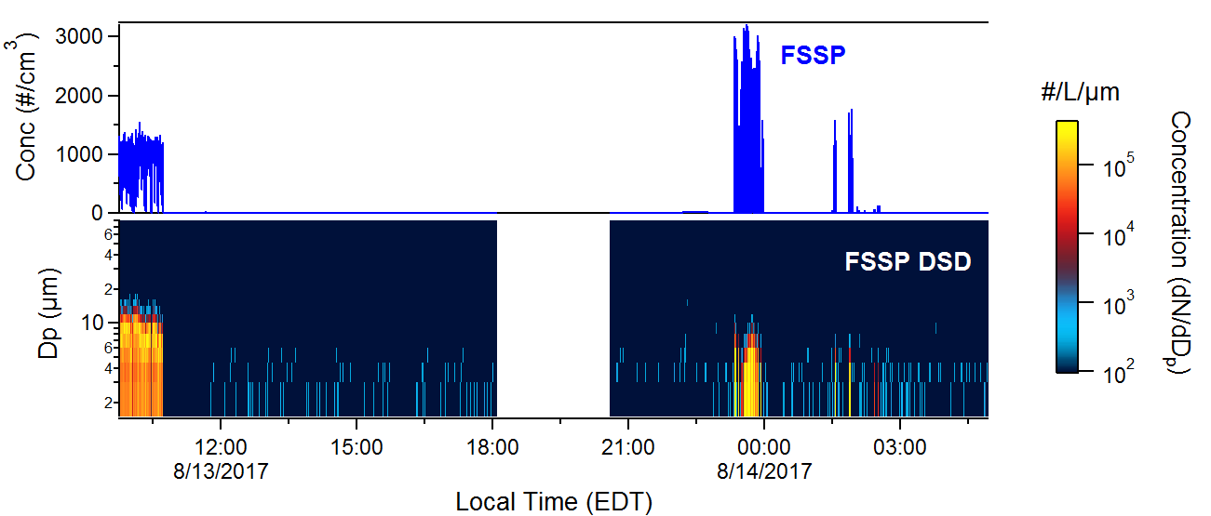

Slide 9
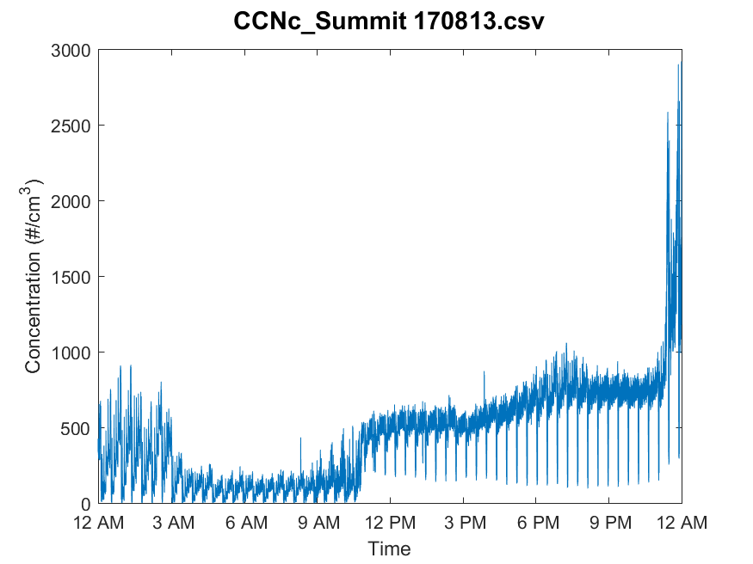

Slide 10
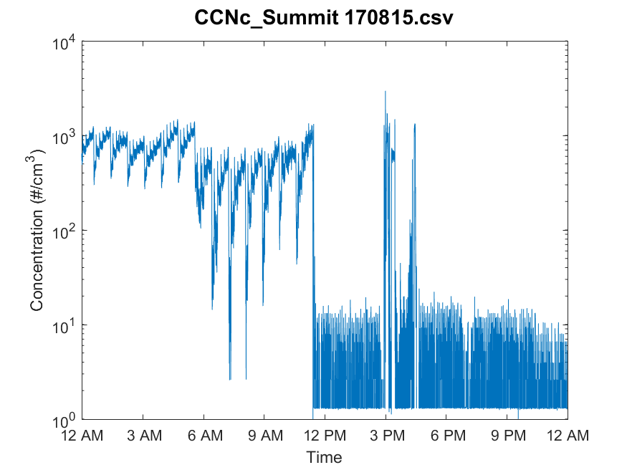

Slide 11
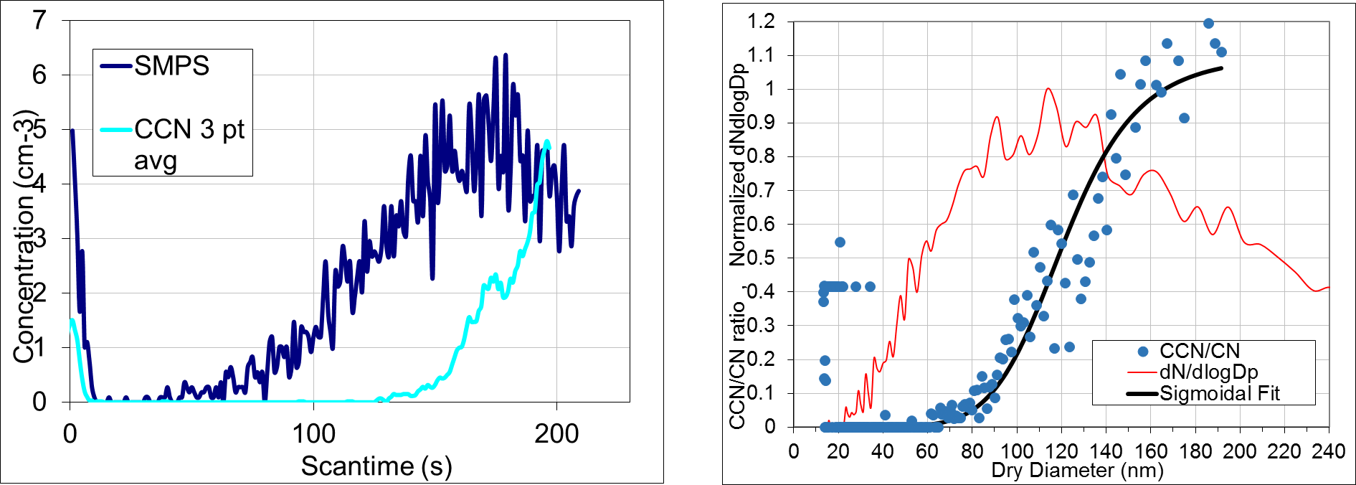
SMCA (Scanning Mobility CCN Analysis)
08/17/2017
Ambient data, averaging over 26 scans at 0.4% Supersaturation

Slide 12
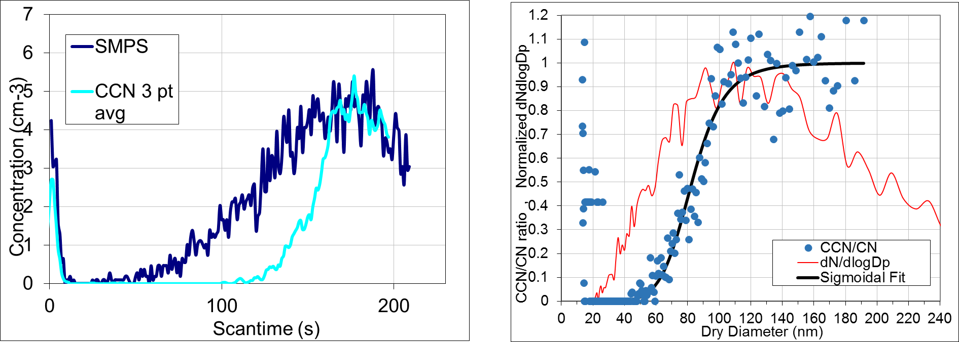
SMCA (Scanning Mobility CCN Analysis)
08/17/2017
Ambient data, averaging over 26 scans at 0.6% Supersaturation

Slide 13
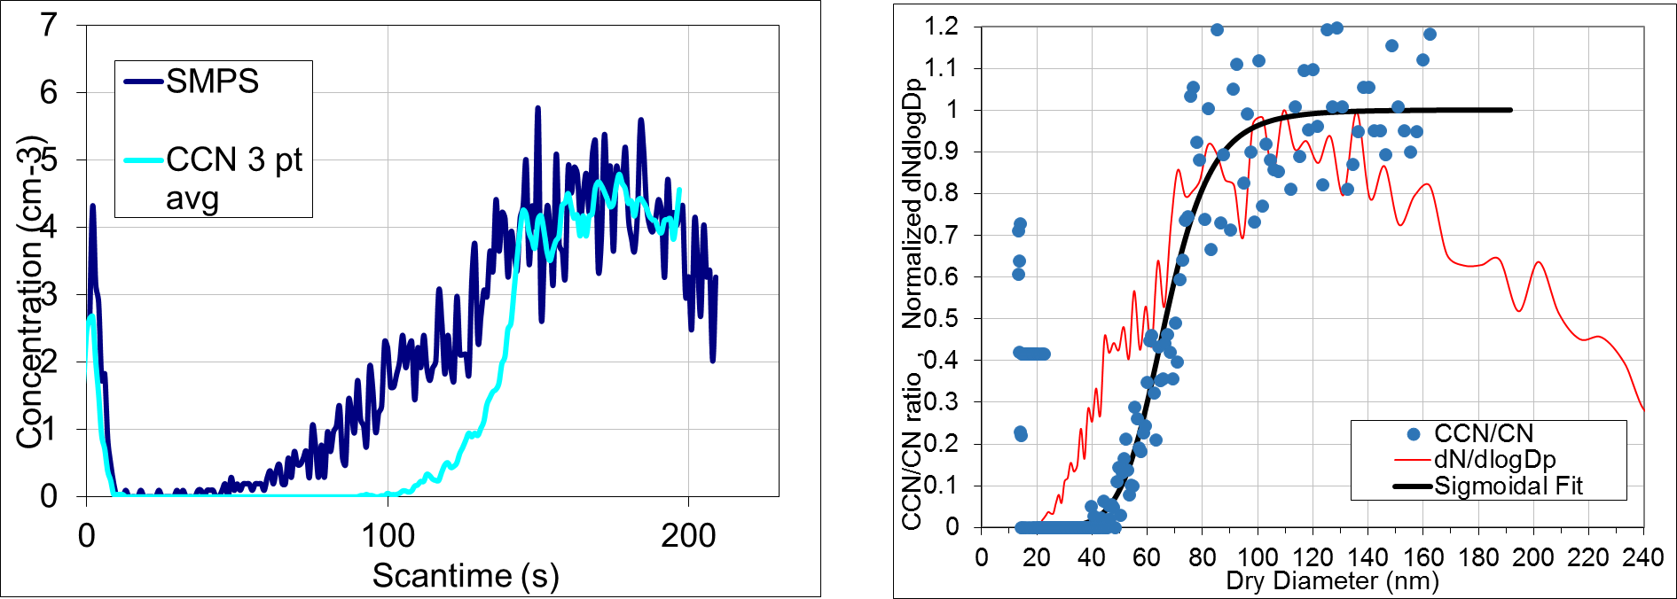
SMCA (Scanning Mobility CCN Analysis)
08/17/2017
Ambient data, averaging over 26 scans at 0.8% Supersaturation

Slide 14
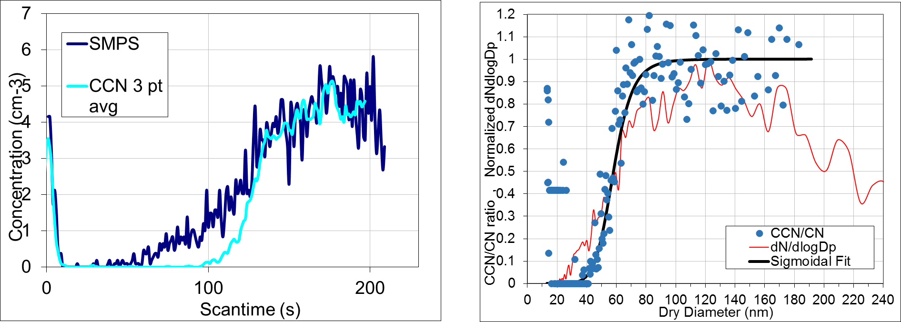
SMCA (Scanning Mobility CCN Analysis)
08/17/2017
Ambient data, averaging over 26 scans at 1.0% Supersaturation

Slide 15
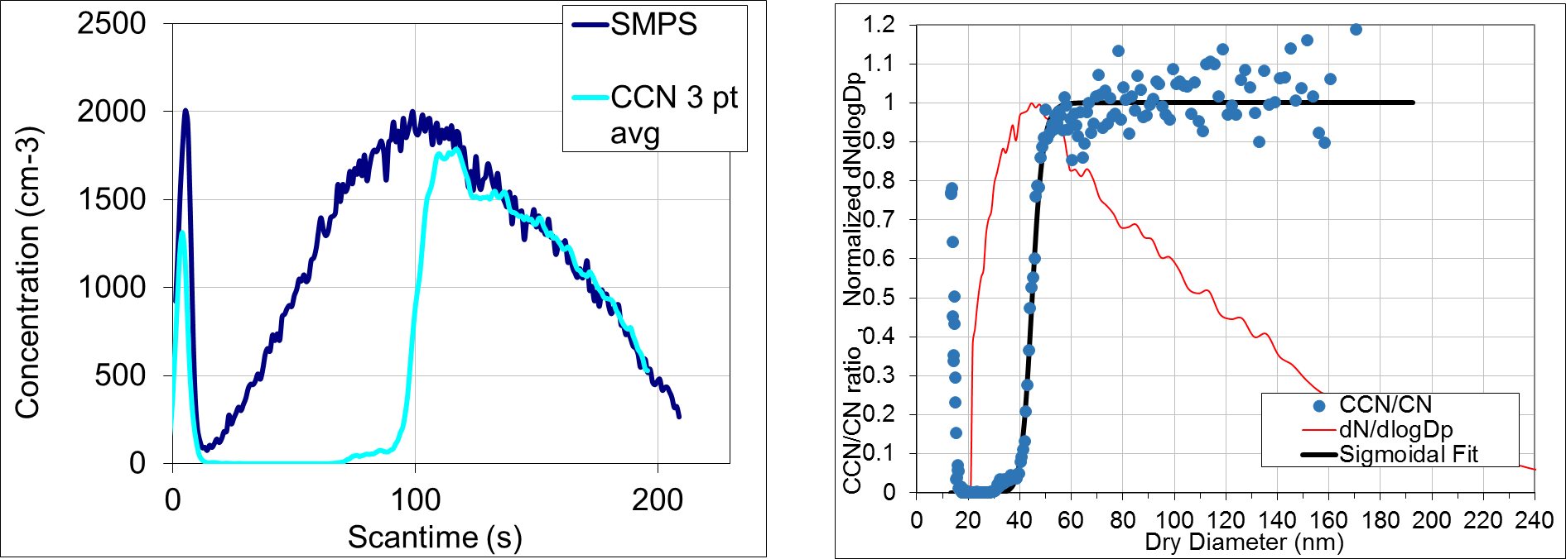
SMCA (Scanning Mobility CCN Analysis)
08/21/2017
Calibration data w/ AS, 1 scan at 0.6% Supersaturation

Slide 16
SMCA (Scanning Mobility CCN Analysis)
08/17/2017
Ambient data, averaging over 26 scans at 0.6% Supersaturation

Slide 17
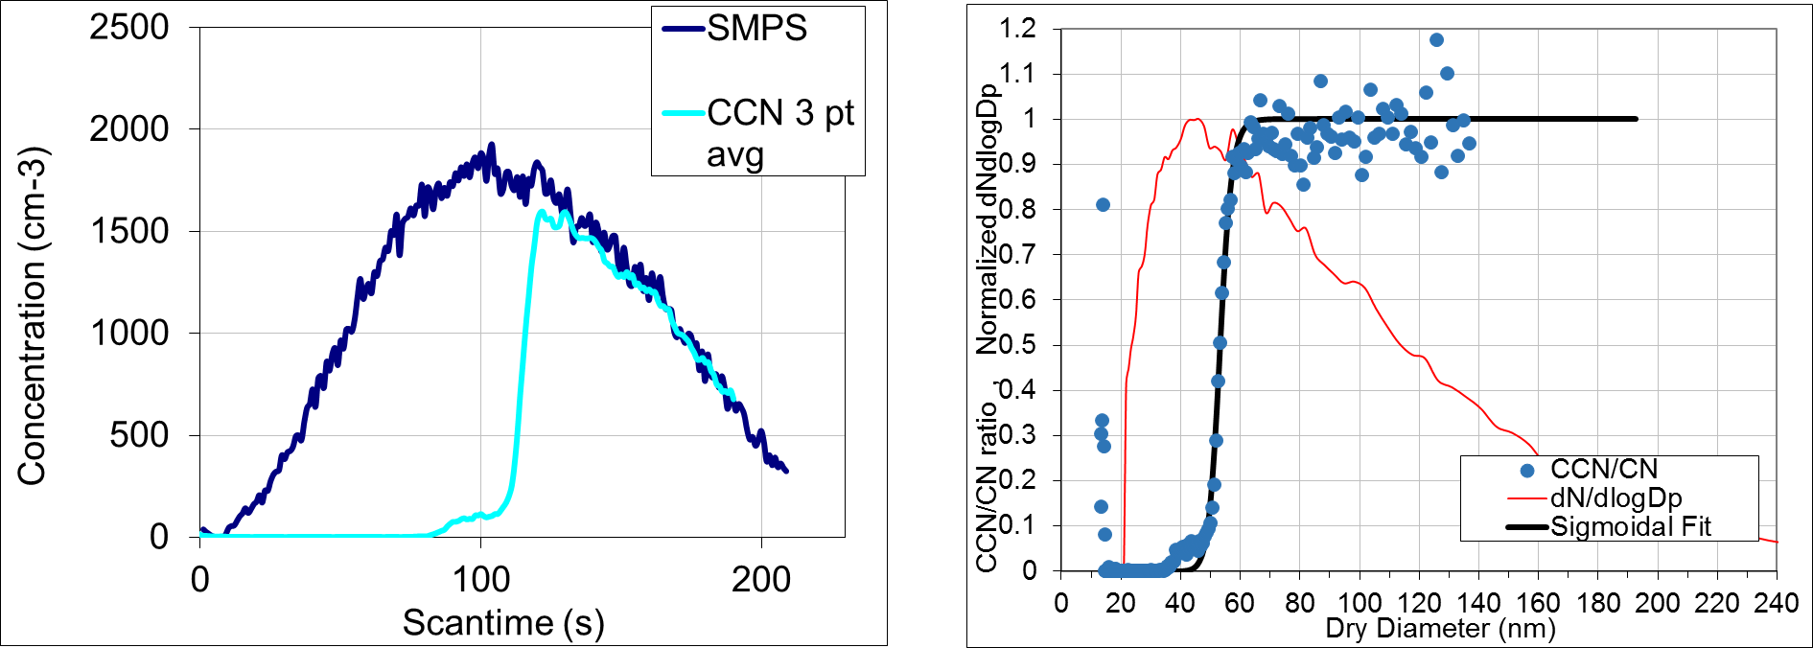
SMCA (Scanning Mobility CCN Analysis)
08/21/2017
Calibration data w/ AS, 1 scan at 0.4% Supersaturation

Slide 18
SMCA (Scanning Mobility CCN Analysis)
08/17/2017
Ambient data, averaging over 26 scans at 0.4% Supersaturation

Slide 19
Size-resolved CCN measurements = information about aerosol chemical composition
Hygroscopicity Parameter (kappa) for ammonium sulfate is ~0.6
For Organics compounds, kappa is typically < 0.2
(Petters and Kreidenweis, 2007)

Slide 20
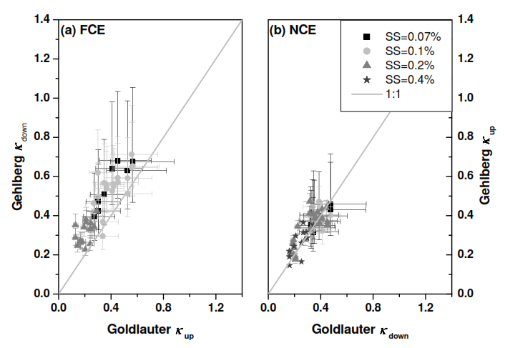
German Study Comparing Hygroscopicity Parameter (kappa) at upwind and downwind sites on cloudy and clear-air days
Full Cloud Events
Non-
Cloud
Events
(Henning et al, 2014)

