Slide 1
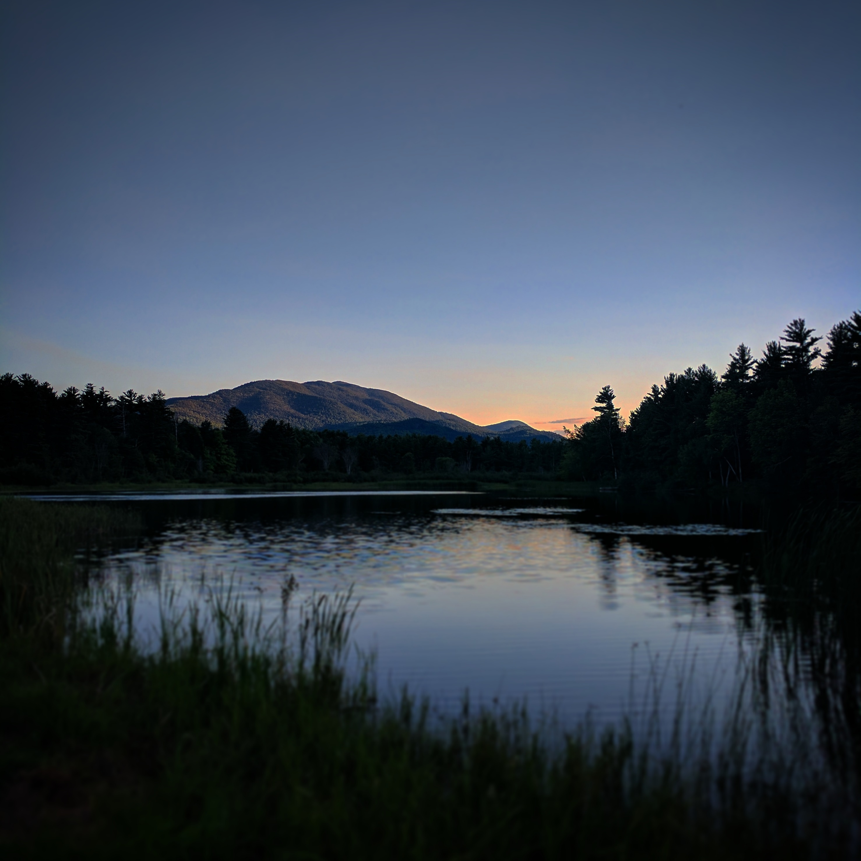
CPOC Pilot Study
Matthew Brewer

Slide 2
Responsibilities
Weather Forecasting
Balloon Launches and sounding plots
Parsivel Disdrometer drop size distributions
Collecting data from Onset Met towers
iButton deployment and data collection

Slide 3
Weather Forecasting
Daily forecast focusing on:
LCL’s
Chance of Precip
Wind speed and direction
Give weather briefing to the group or informally discussing whether the next day will be favorable for an IOP and what the next couple days were going to be like

Slide 4
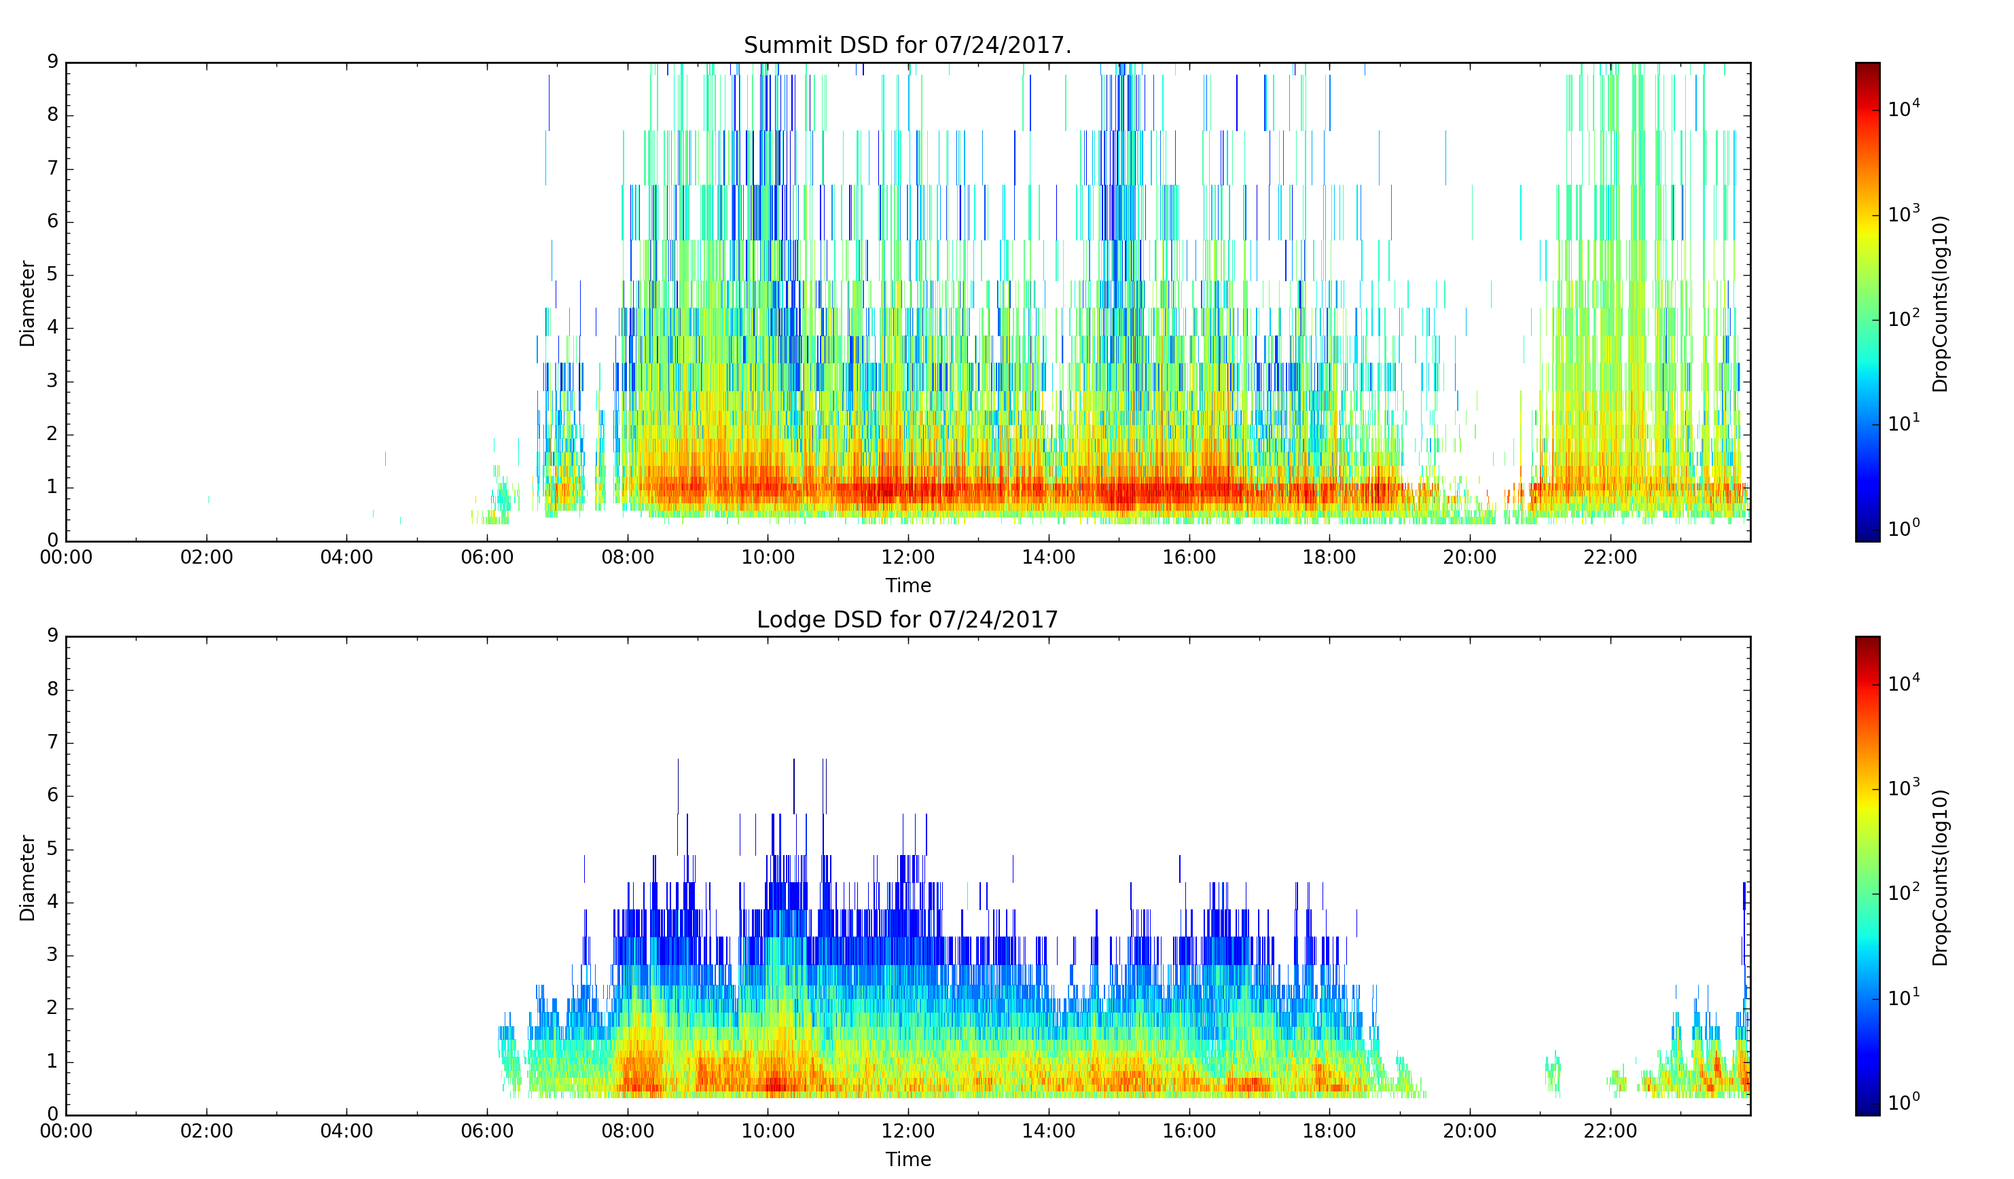
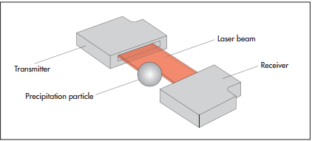
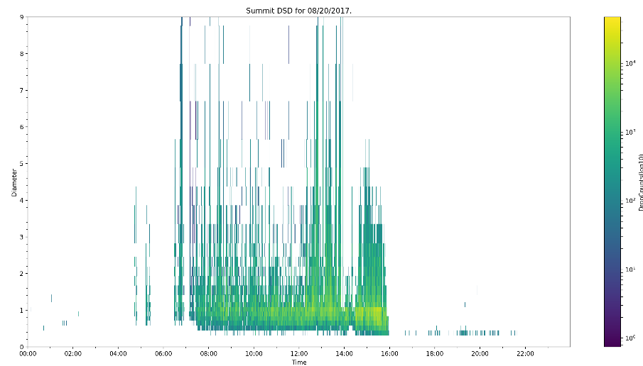
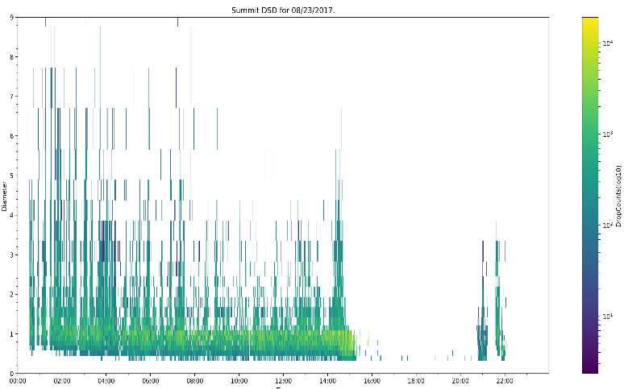
Parsivel Disdrometer

Slide 5
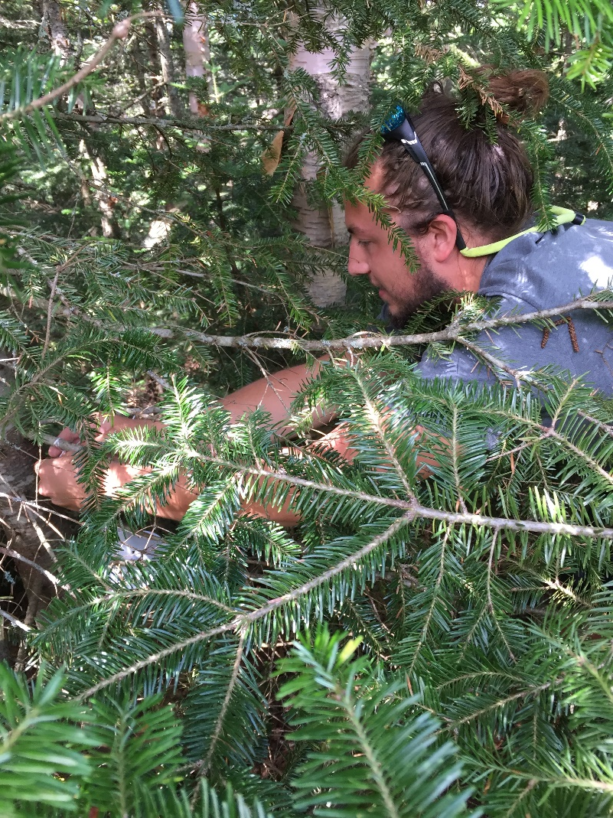
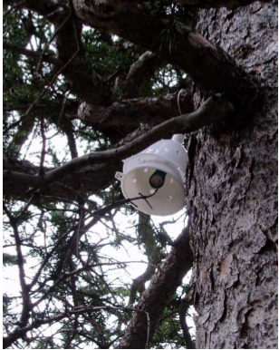
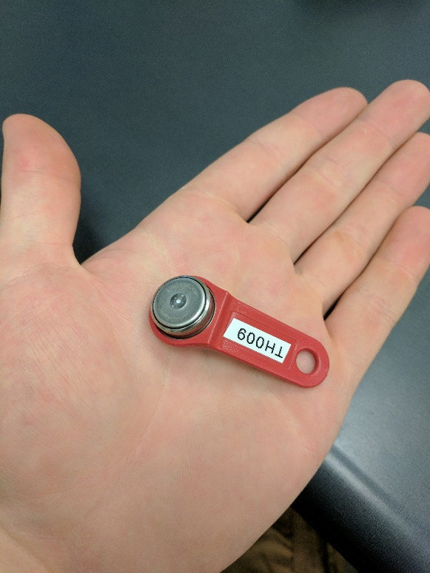
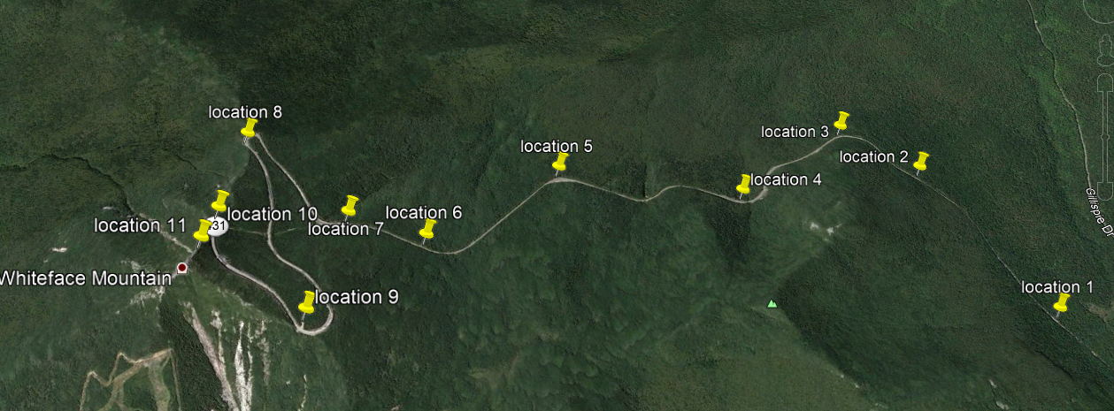
iButton deployment
Deployed 11 iButton temperature and humidity sensors along the Memorial highway
Set to sample data once every 30 minutes
Can log up to 4096 data points
Following project, we plan to change the logging interval to 2 hourly therefore they will be able to log until roughly next May

Slide 6
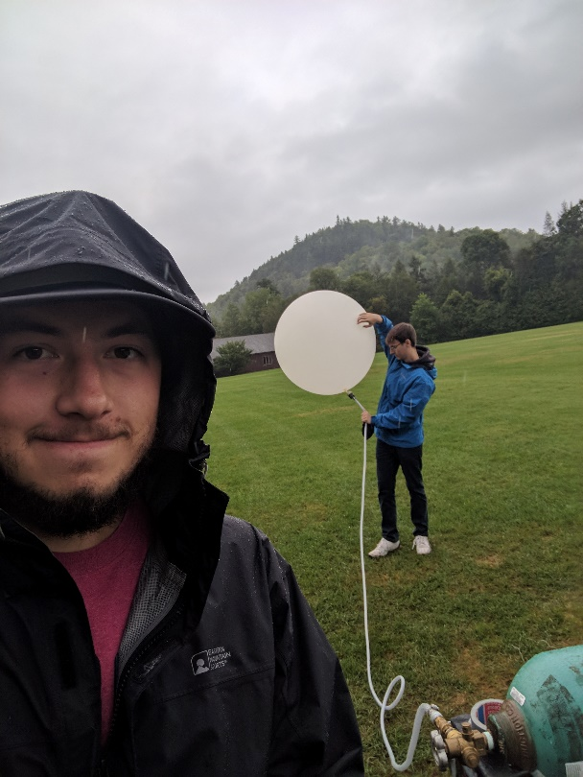
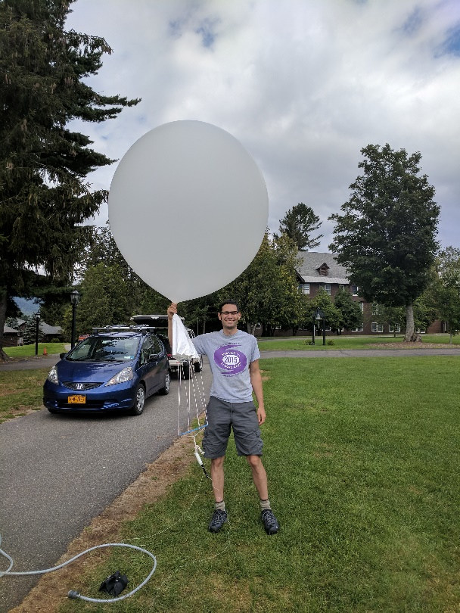
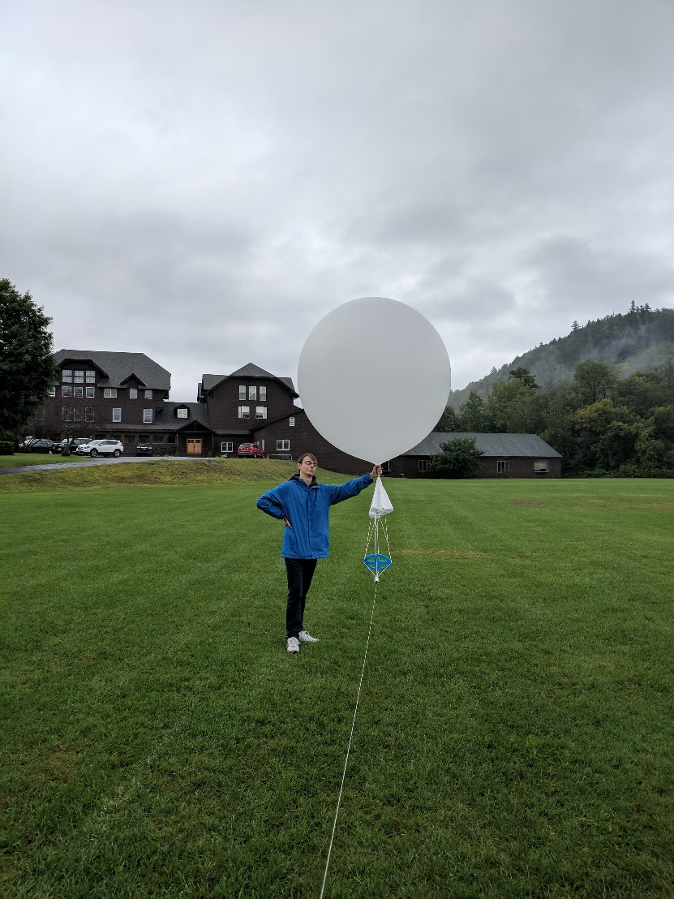
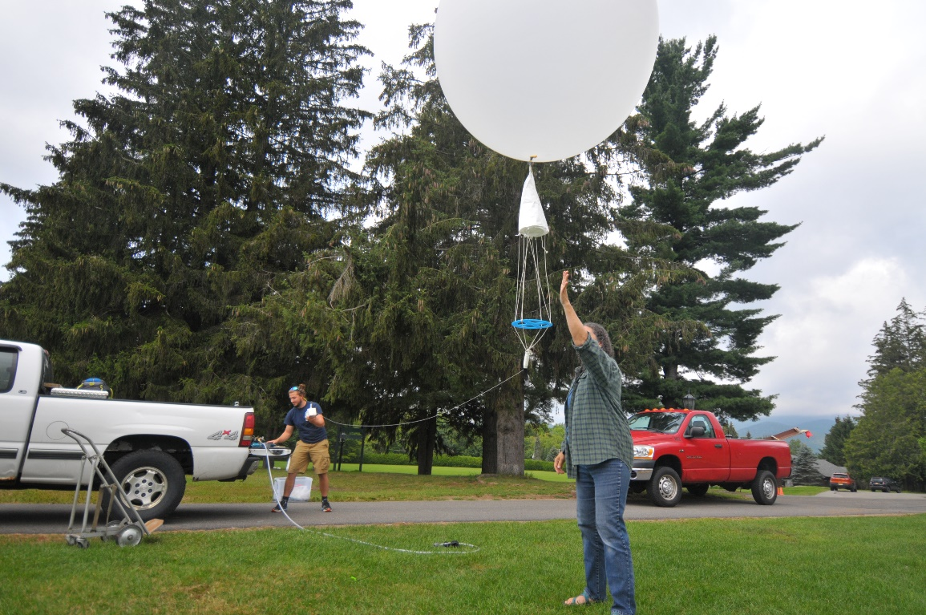
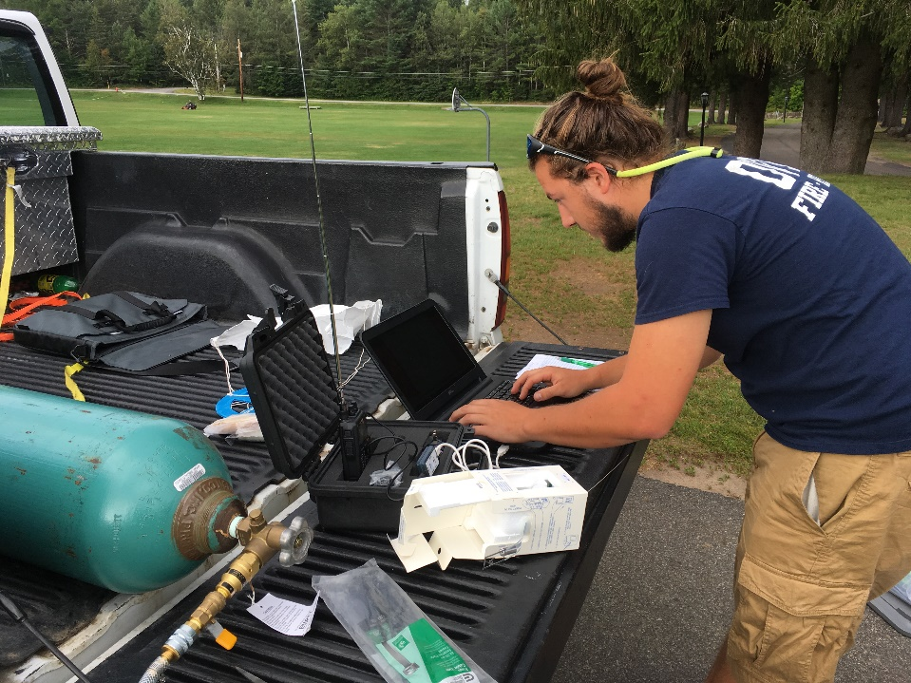
Weather Balloon Launches

Slide 8
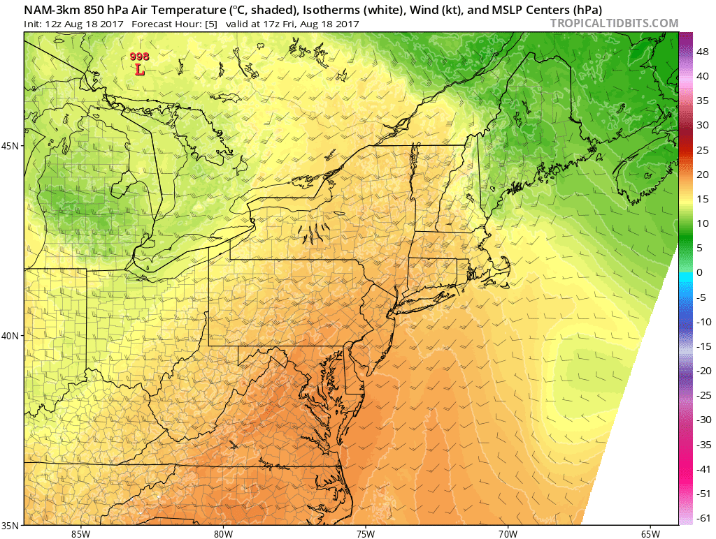
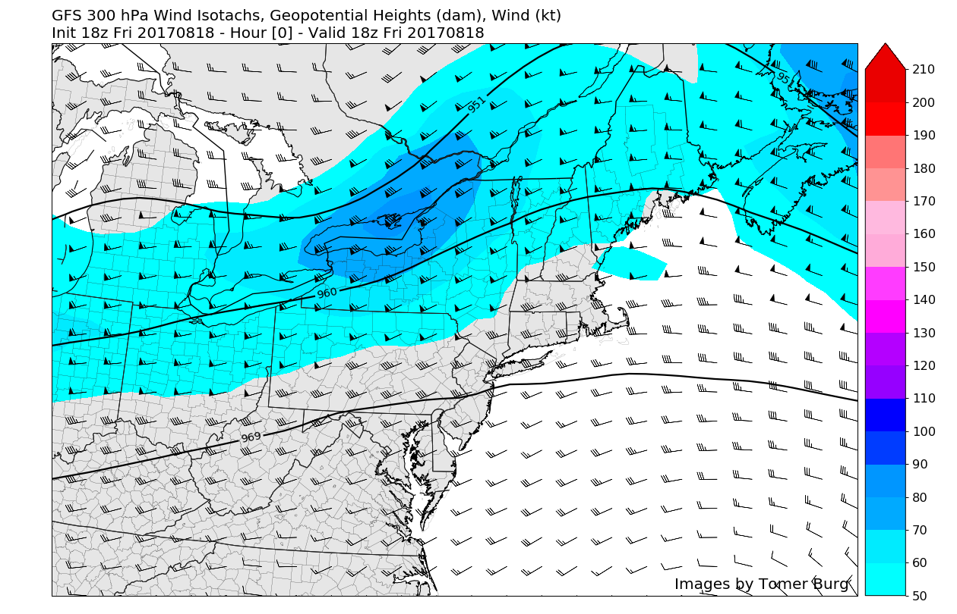

Slide 9
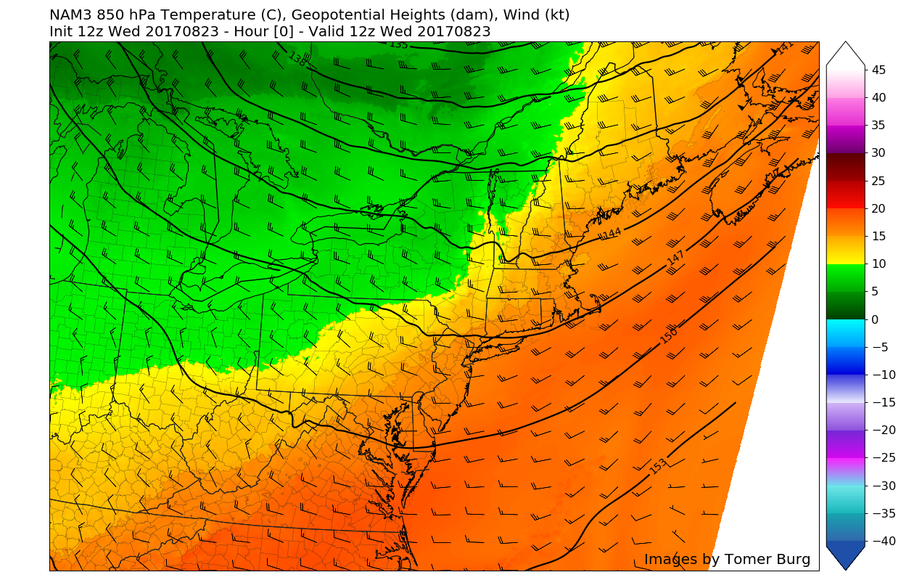
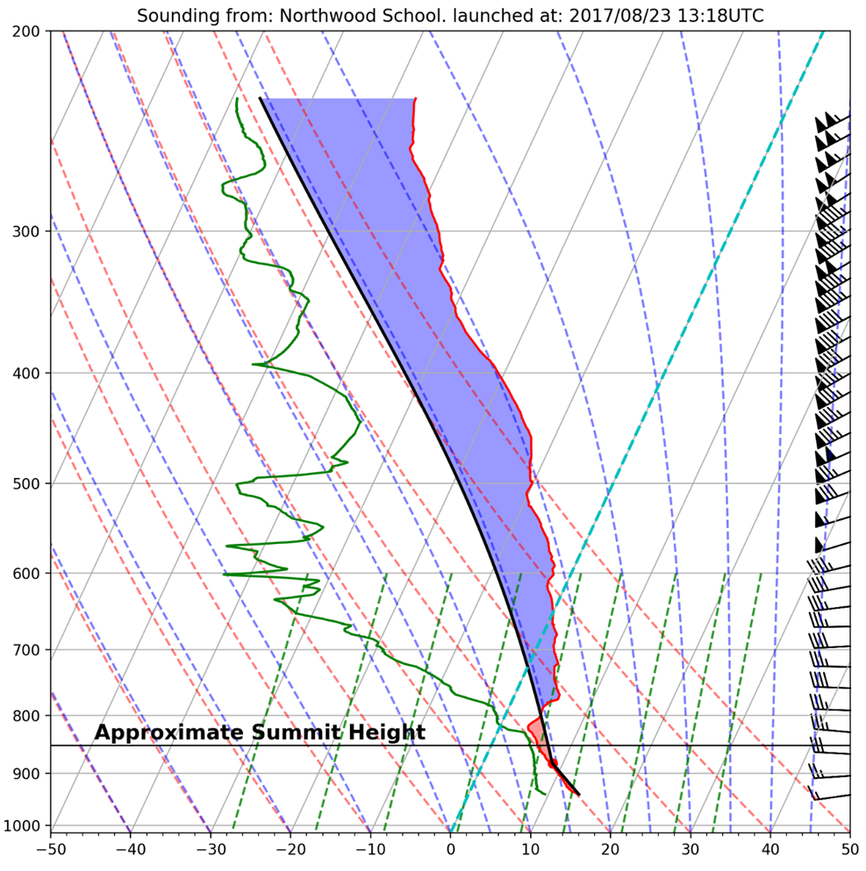

Slide 10
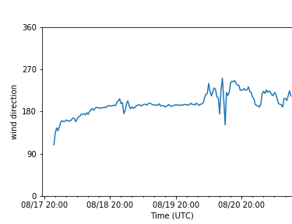
Onset Met Towers
Summit
Lake Placid Turn

Slide 11
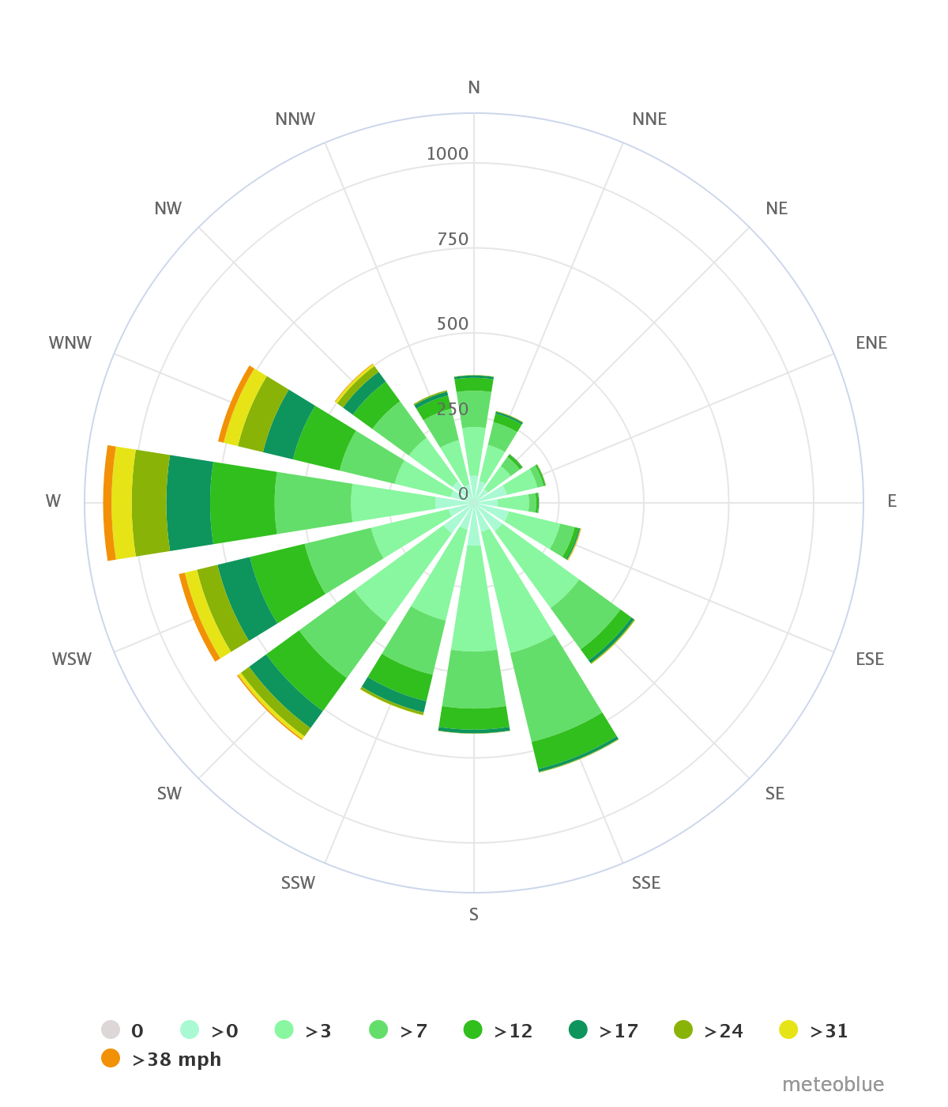
Lake Placid Wind Rose

Slide 12
