Slide 1
Pilot Study Recap
By Daniel Orlowski

Slide 2
Objective
Simplify the process of reorienting the FSSP, towards some optimal
direction based on weather conditions.

Slide 3
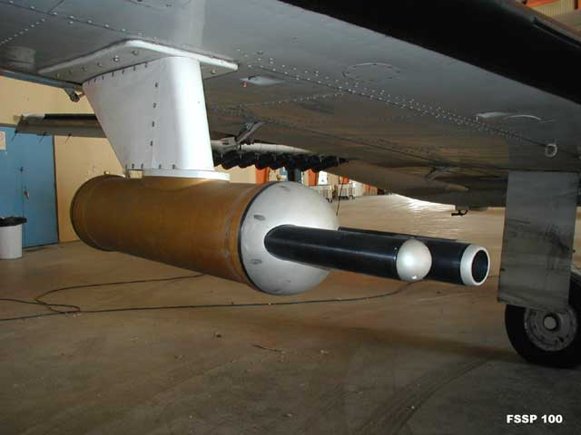
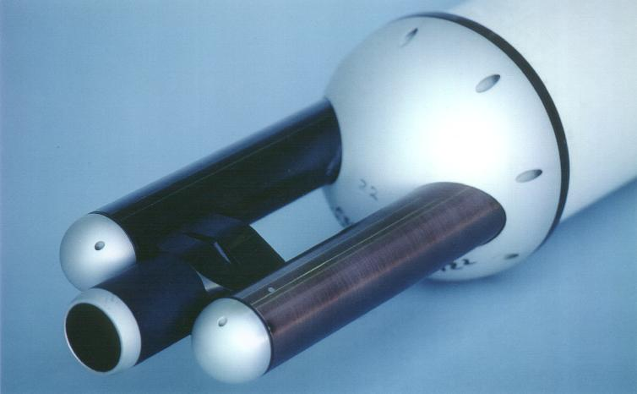
FSSP
Notes:
Mounted on a moving aircraft, air intake is simple.
Addition of blower necessary to improve sample intake

Slide 4
Background
FSSP should face into the wind during desirable conditions
  In cloud
FSSP should face away from the wind in undesirable conditions
  In any precipitation

Slide 5
Solution
Mount the FSSP on a geared turntable, powered by a geared stepper motor
Use inputs from various meteorological instruments located on the summit
Use a microcontroller to process these inputs
Use a stepper driver to convert these processed inputs into specific pulses and wavelengths which can drive the motor
Notes:
Required inputs: wind direction, presence/absence of precipitation
Fine control over turntable necessary due to importance of position

Slide 6
Simplified Block Diagram
(INPUT)
Wind Direction
Microcontroller
Stepper Driver
+
Motor
(INPUT)
Rain Status
(OUTPUT)
Turntable Position
Notes:
Start with microcontroller

Slide 7
Choice of Microcontroller
Arduino chosen over Raspberry Pi
Ease of use

Slide 8
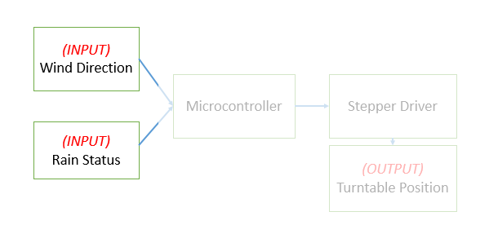
Inputs

Slide 9
Inputs – Rain Sensing
Not implemented
Simple to retrofit a rain sensing component
  Rain sensor connected to I/O port
  Flips a flag from 0 to 1, adjusting position call +/- 180 degrees
Notes:
Not implemented bc time constraints, and because final turntable was only semi-autonomous, removing need for autonomous interpretation of the weather.

Slide 10
Inputs – Wind Direction
Originally, an anemometer, was utilized as an input
Anemometer outputs frequencies in the 100-460 Hz range, corresponding directly to a 0:360 degree range of wind direction
Notes:
Tested back at ASRC with frequency generator and oscilloscope with no issues.

Slide 11
Inputs – Wind Direction
RM Young wind sensor outputs an analog voltage between 0 and 5 volts.
Read by Arduino correctly, input read as a 0:1024 range
Afterwards, mapped to a 0:360 range to correspond to a degree value
Notes:
Linear mapping: 0V/5.0V = North, 2.5V = South

Slide 12
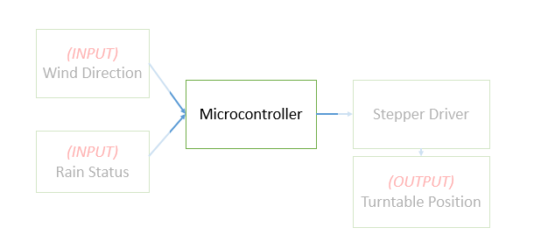
Microcontroller

Slide 13
Microcontroller
Stepper driver requires a specific series of inputs from microcontroller
Used AccelStepper (Arduino library) to simplify these interactions with stepper driver, and smoothen motion
Library allows for setting of a maximum speed and acceleration, and handles most associated calculations
Notes:
Specific inputs of variable frequency, duty cycle, and wavelength to correspond to increasing/decreasing speed and constant speed.

Slide 14
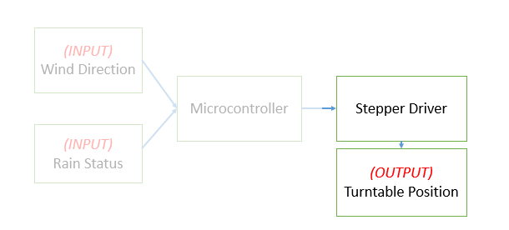
Stepper Driver + Output

Slide 15
Why use a Stepper Driver?
Driver allows for:
  connecting motor to a power source
  supplying motor with necessary voltage/current for given situation
  setting of steps/revolution for motor (from 200 up to 20,000)
  short-circuit, over-voltage, under-voltage protections
  diagnosing issues with microcontroller-motor communications
  disabling motor with a pulse to a specified pin
  ultimately, the conversion of the microcontroller output into readable, stepped motor signals

Slide 16
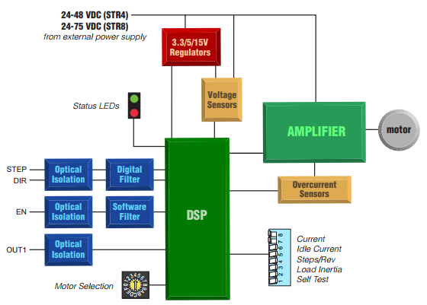
STR-8 Stepper Driver Block Diagram

Slide 17
Motor
With a smaller motor, simplification of system is possible
  Replacement of stepper driver with a much cheaper, stepping circuit
Application, however, required a large, robust motor.
  FSSP = ~50lbs
  turntable subject to torques due to wind
  precipitation, insects

Slide 18
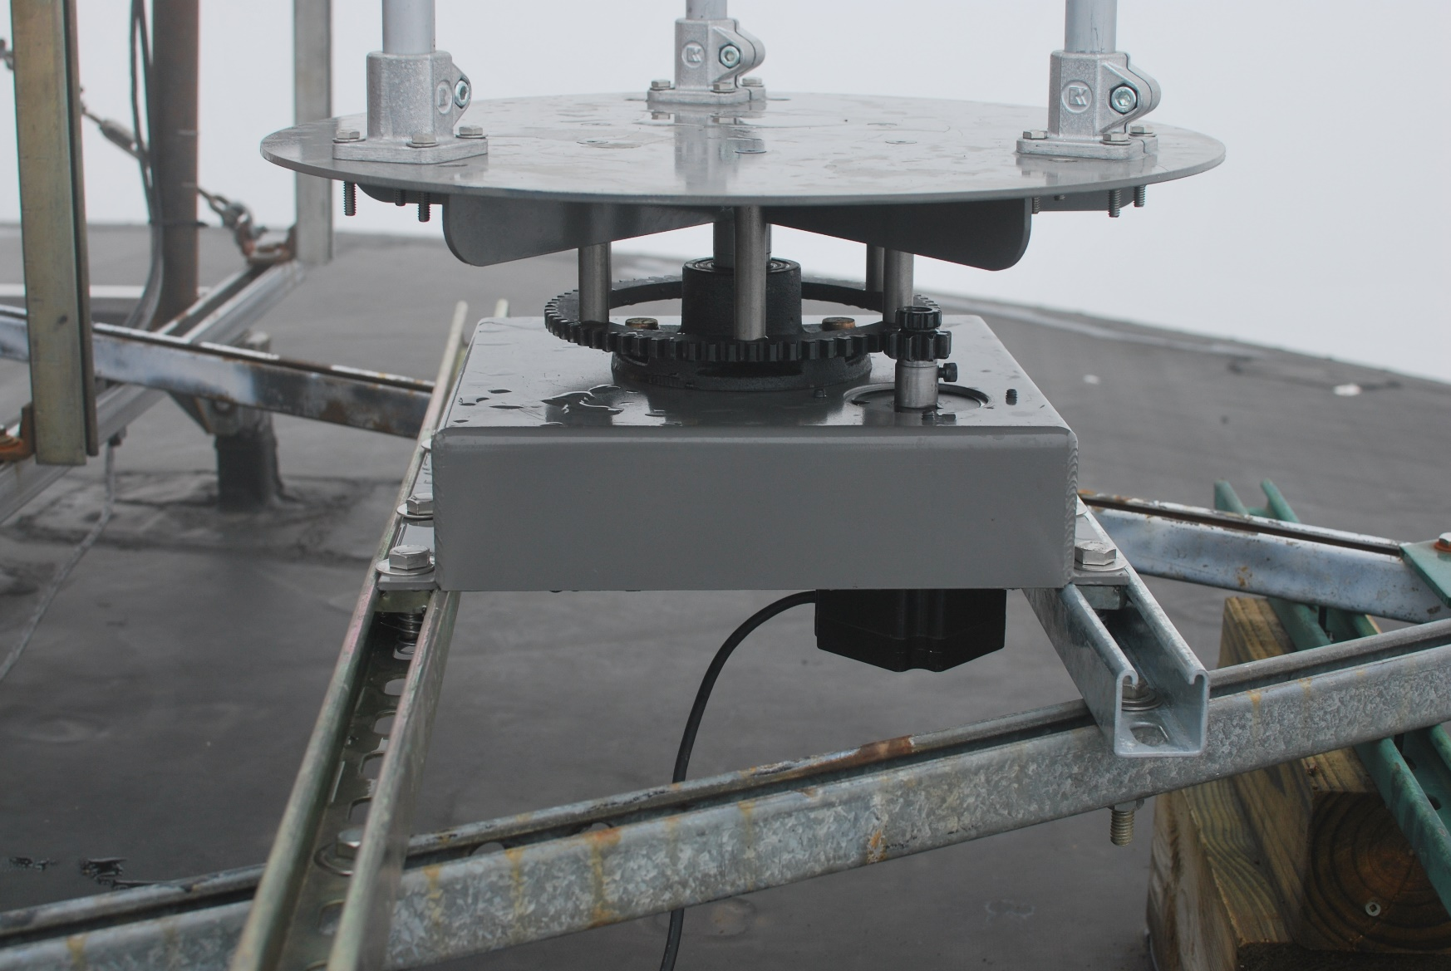
HW34-506 Motor
Robust
  High torque design
  Sealed laminations
  Rated IP65 for wet
  and dusty environments
Notes:
Handles the insect situation, the torque requirements, the precipitation

Slide 19
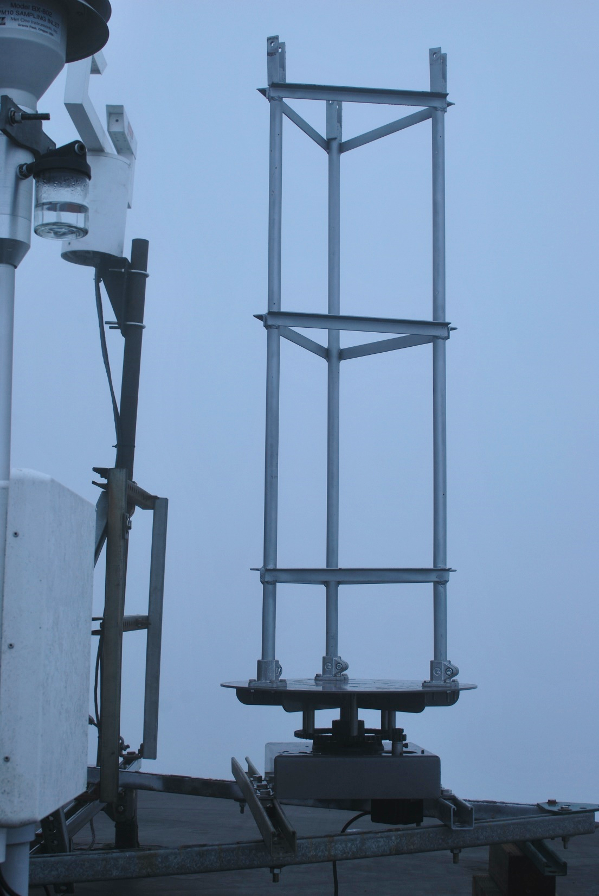
Turntable
Turntable itself is designed for
sand-blasting cabinets
Abrasion resistant, powder coated
Ring gear mounted on underside,
to interface with pinion on motor
Notes:
As you can see, there’s a lot more that went into assembling everything into one functioning piece
Turntable began to rust somewhat in spots where it was scratched or drilled into.

Slide 20
Code Implementation
Read 30 consecutive analog inputs for wind direction
  Average them out
Map average wind direction from 0:360 to 0:14667 to get your position call
  14667 = motor steps per turntable revolution
Move motor this calculated number of steps, with your set max speed and max acceleration.
Notes:
Code accounts for timing of acceleration and deceleration of motor

Slide 21
Code Implementation
Separate program written for manual control over turntable
Available on SMPS laptop
Prompts for a degree input from user (for wind direction)
  Reads input
  Asks whether in cloud or in precipitation
  Moves to given position based on responses
  Waits until newly input position

Slide 22
FSSP Cable Tangling
“Zero out” function utilized
Turntable returns to zero after calculating new position
  Takes shortest route to zero, and then shortest route to new position
  Essentially untangles cord before moving to new position
Event of motor losing power?
  Motor restarts with instantaneous position treated as zero
  This allows for tangling, if starting position has sufficiently tangled cable

Slide 23
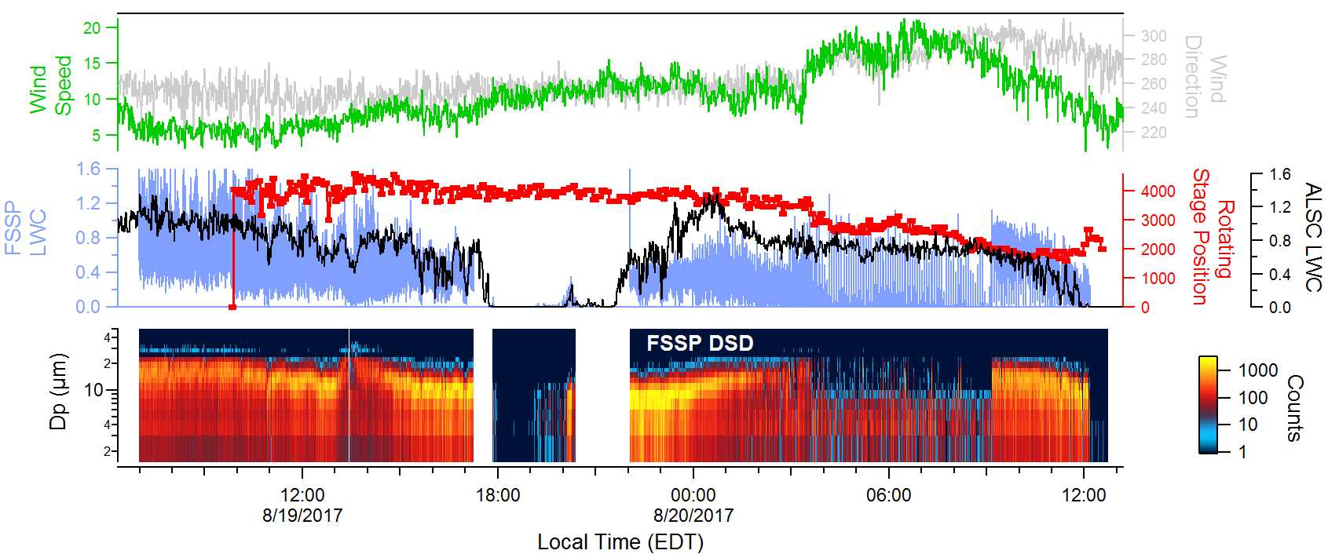
8/19 – 8/20

Slide 24
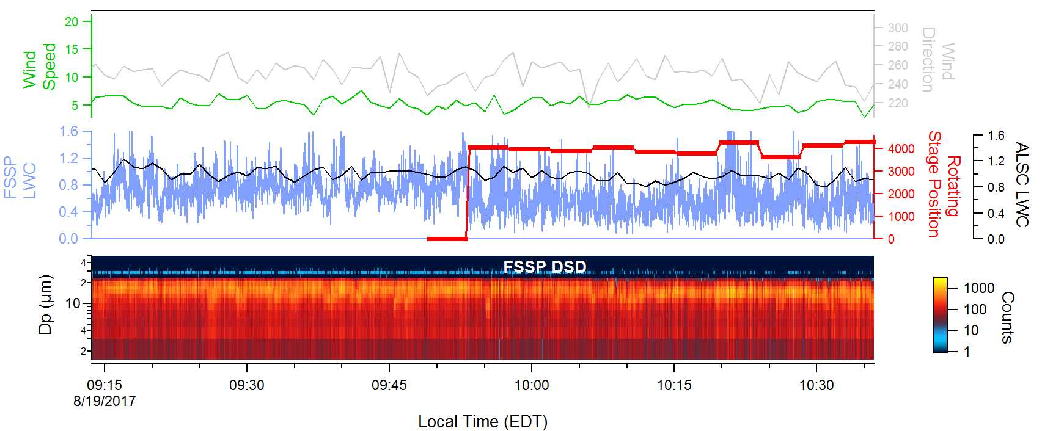
8/19 Morning

Slide 25
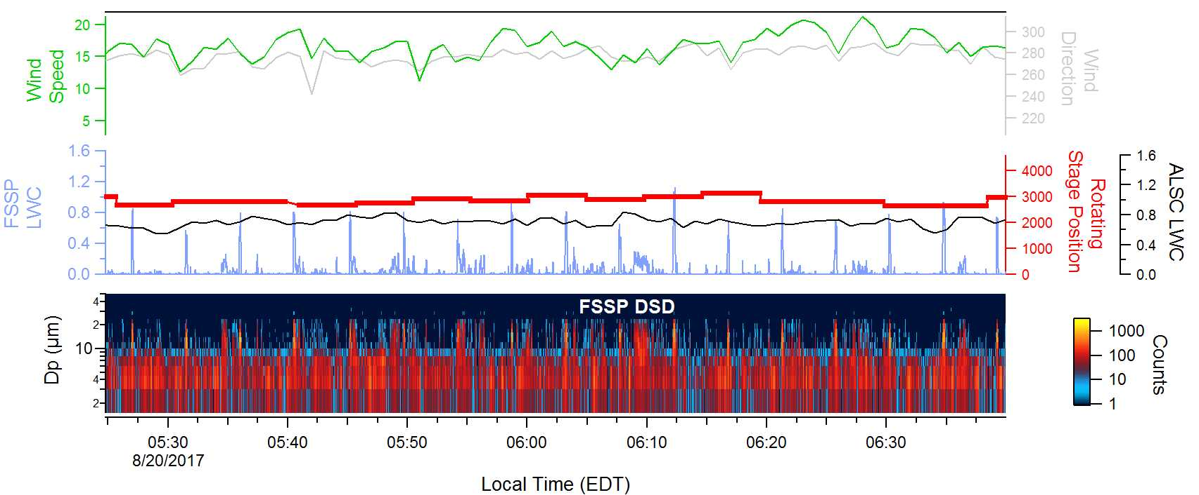
8/20 Morning

Slide 26
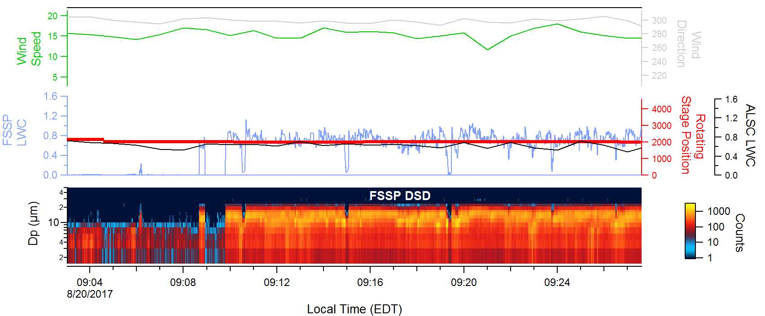
8/20 Morning Continued

Slide 27
Future Improvements
Test turntable off-site to confirm it is tangle-proof
  Use spool, tie end to turntable, run for X hours
  Afterwards, check if spool is tangled around turntable
Run more extensive diagnostics on turntable off-site
  Leave running for days at a time, log results, diagnose
Add wireless capabilities to Arduino (network shield)
  Allows for direct data logging to a server, removes need for USB connection to laptop
Add rain sensing component to Arduino
New turntable coat, to prevent rusting

