Slide 1
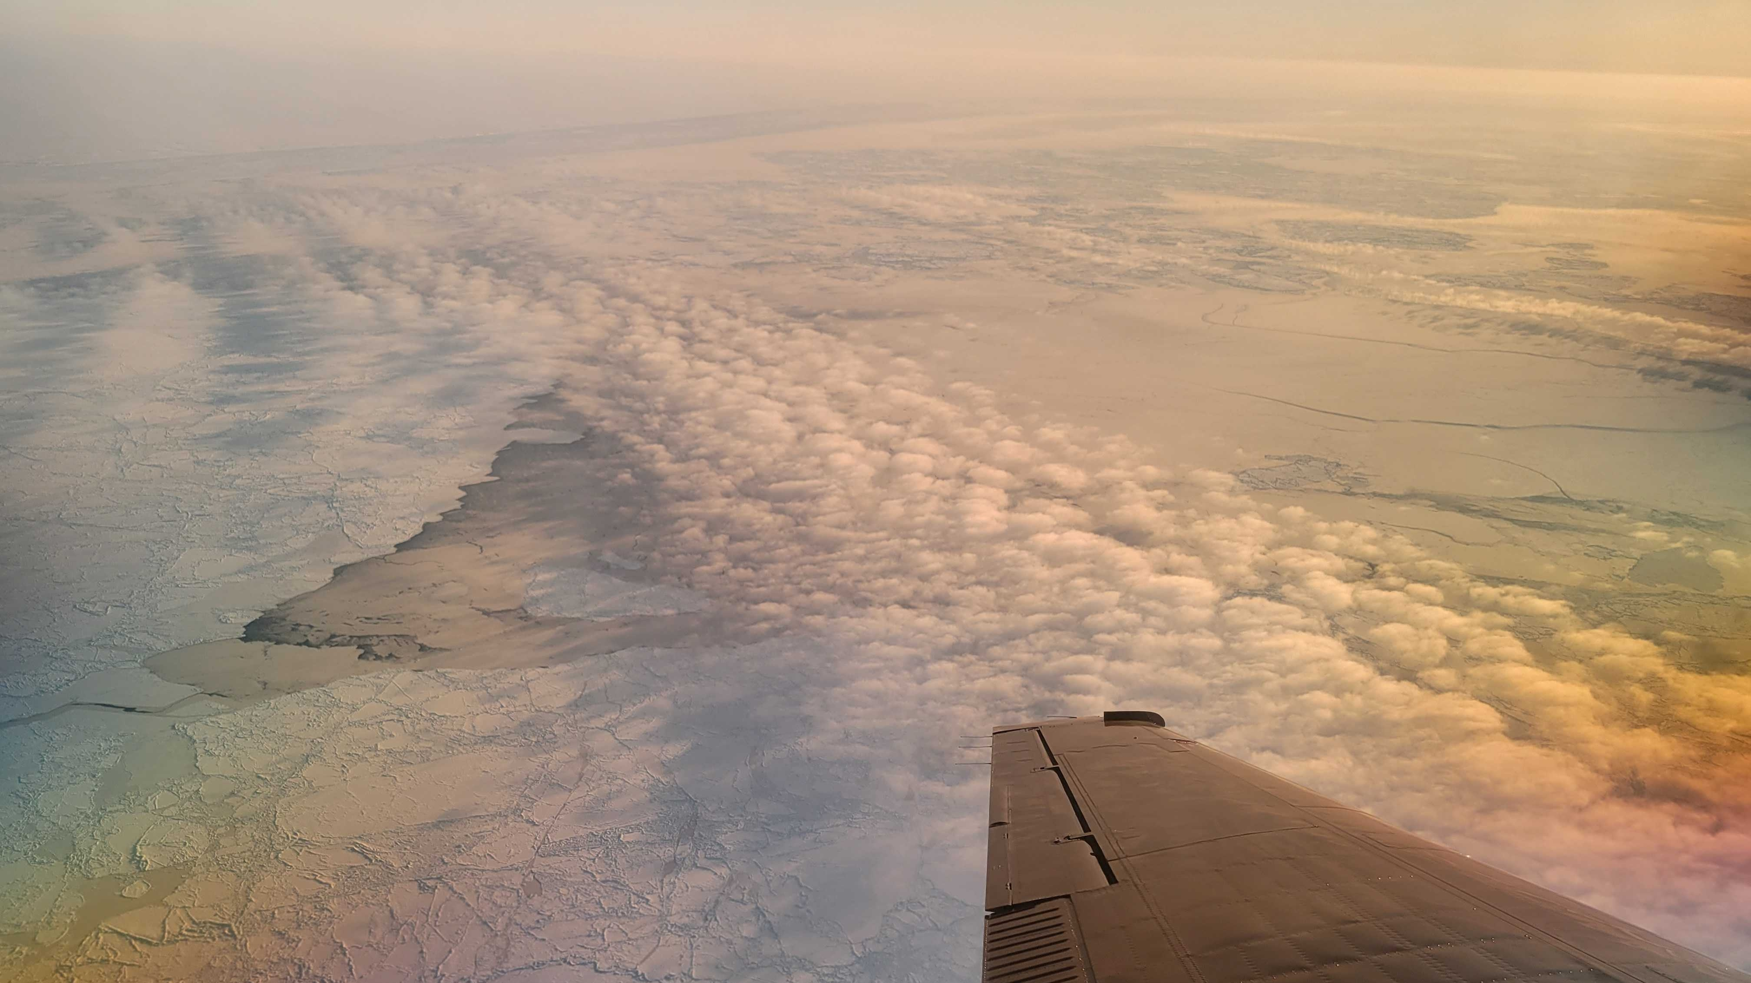
Chemistry in the Arctic: Clouds, Halogens, and Aerosols (CHACHA) Feb-Apr 2022
AMS Meeting
January 10, 2023
Sara Lance¹, Kerri Pratt², Paul B Shepson³, Jose D Fuentes⁴, William R Simpson⁵, Sarah Woods⁶, Daun Jeong², Natasha Garner², Kristian Daniel Hajny³, Nathaniel Brockway⁸, Andrea F Corral⁹, Peter Peterson¹¹, Aaron Wang^{4,13}, Carol Costanza⁶, Katja Bigge⁷, Christine Hrycyna¹⁰, Robert Kaeser¹⁰, Tim Starn¹², Brian H Stirm¹⁰, Ying Pan⁴, Armin Sorooshian⁸
¹University at Albany, ²University of Michigan, ³Stony Brook University, ⁴Penn State University, ⁵University of Alaska, Fairbanks, ⁶NCAR, ⁷University of Heidelberg, ⁸UCLA, ⁹University of Arizona, ¹⁰Purdue University, ¹¹Whittier College, ¹²West Chester University, ¹³PNNL
Photo Credit: Sarah Woods
Notes:
Collaborative field project funded by NSF that took place a little over one year ago.

Slide 2
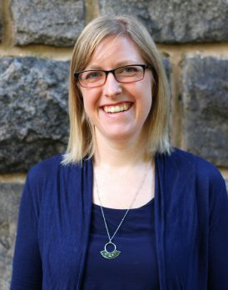
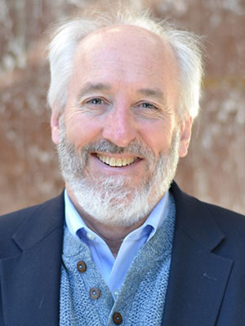
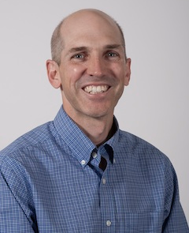
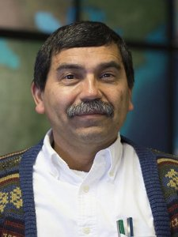
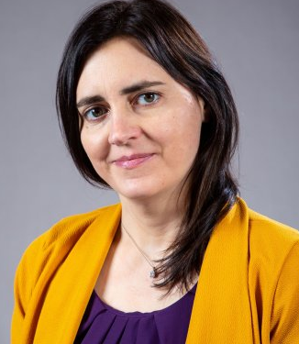
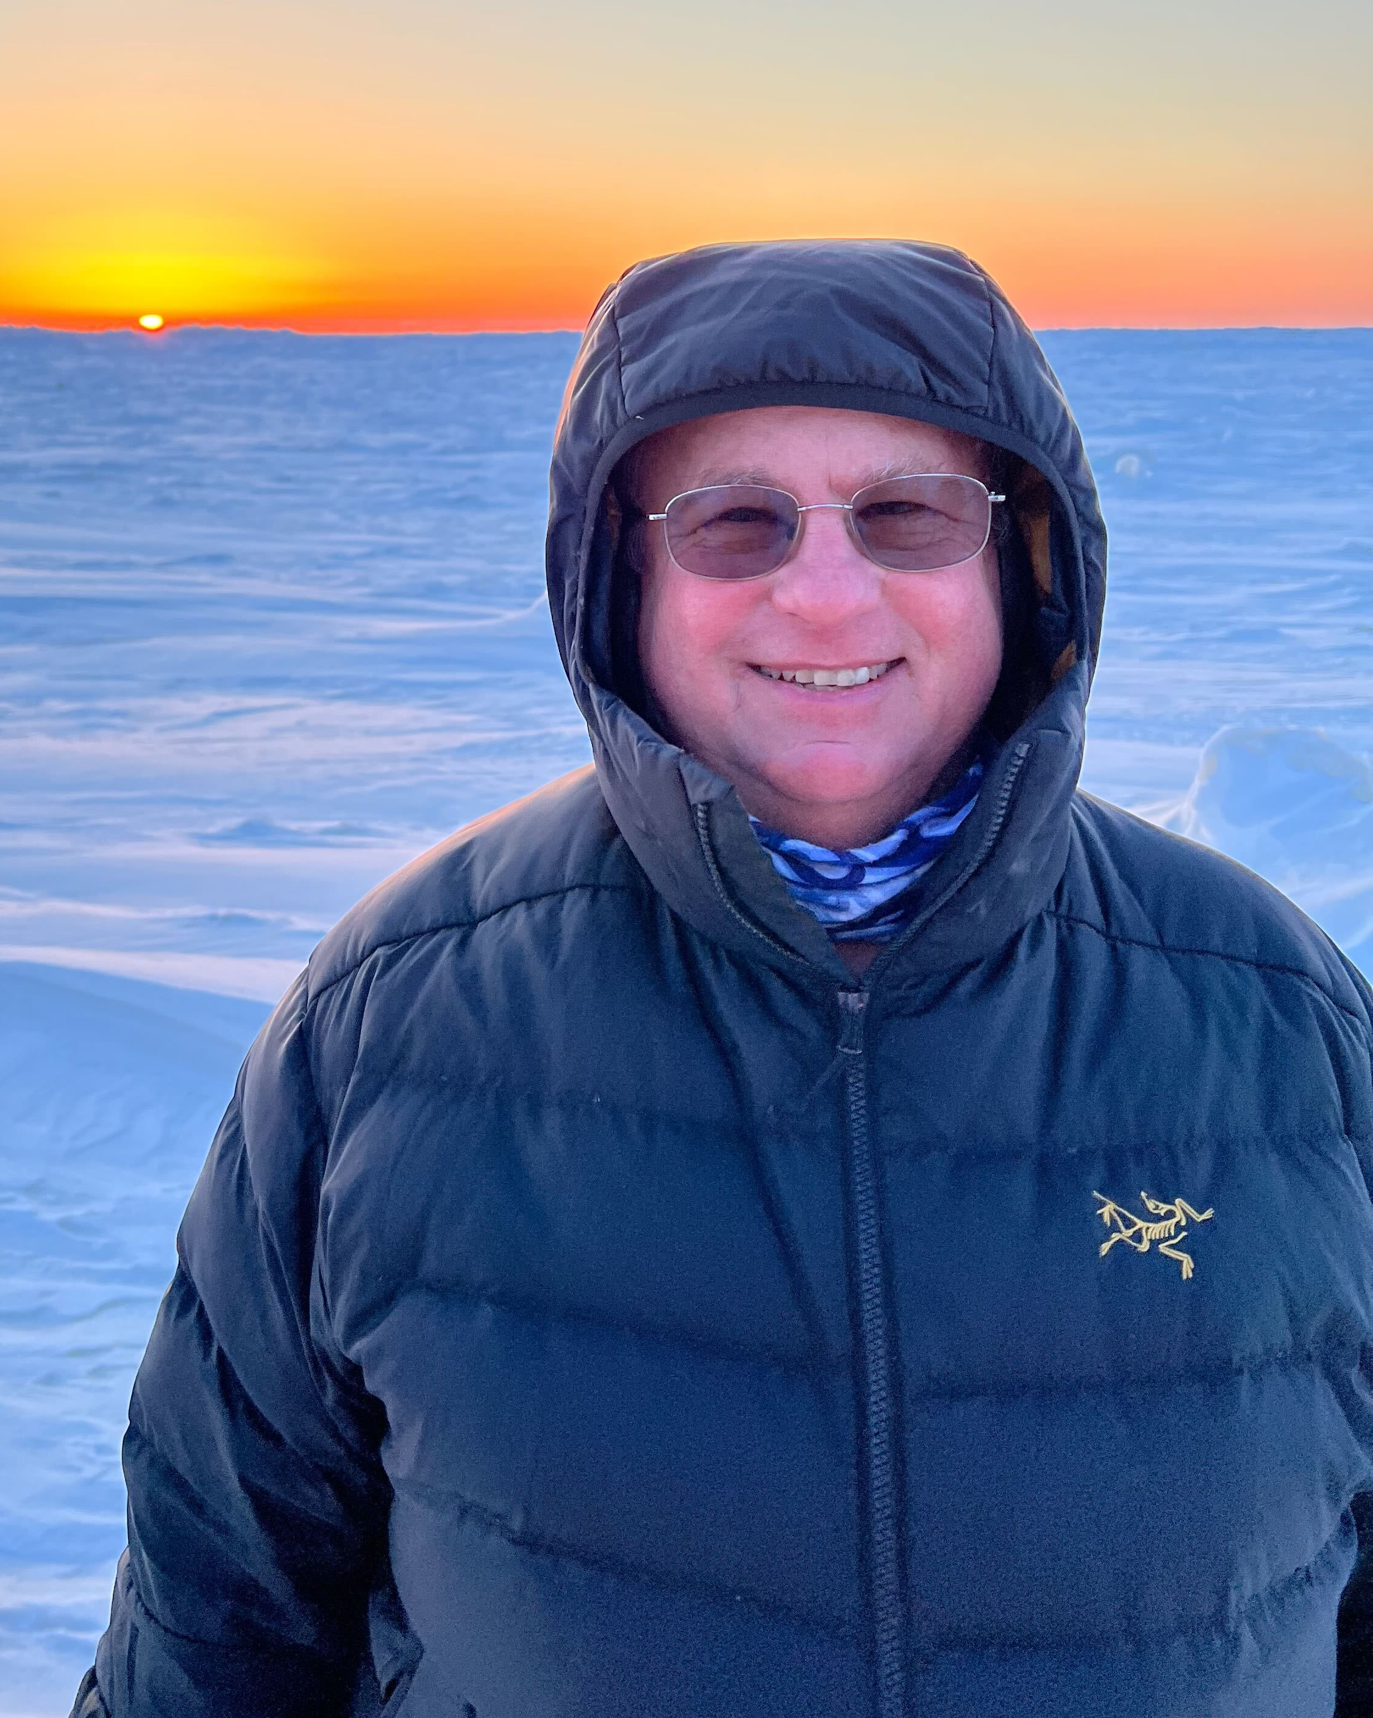
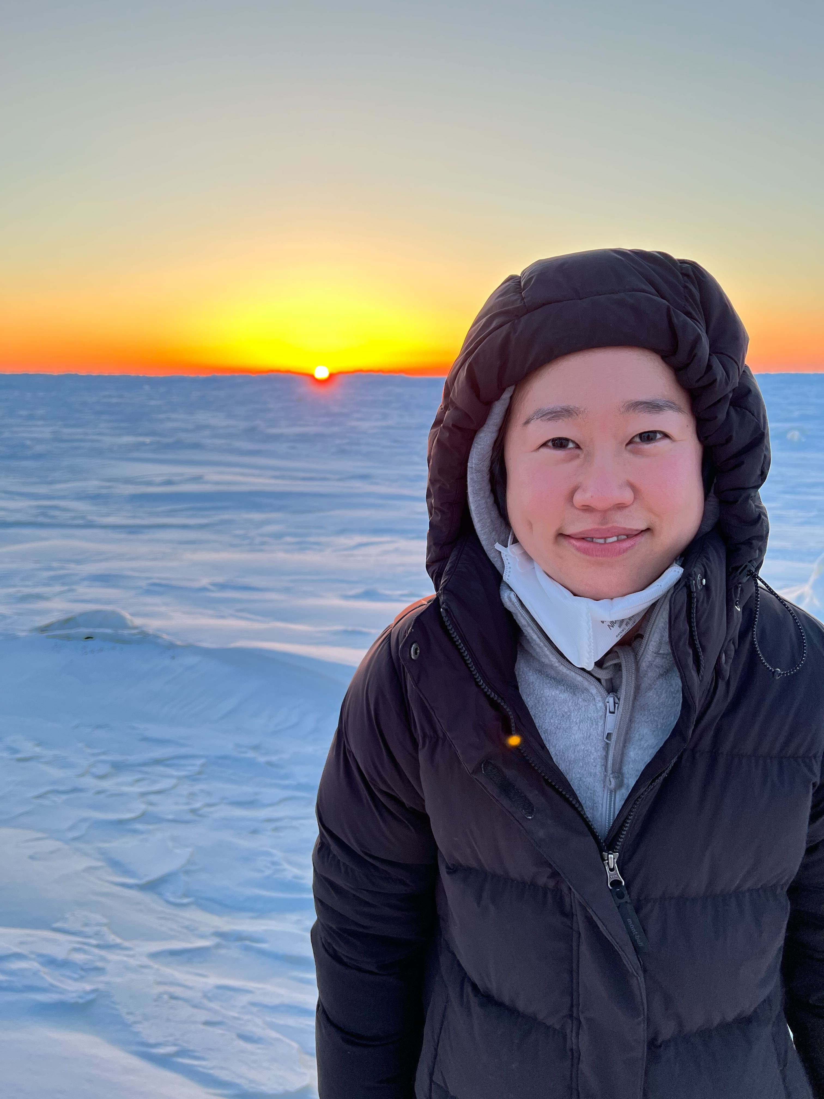
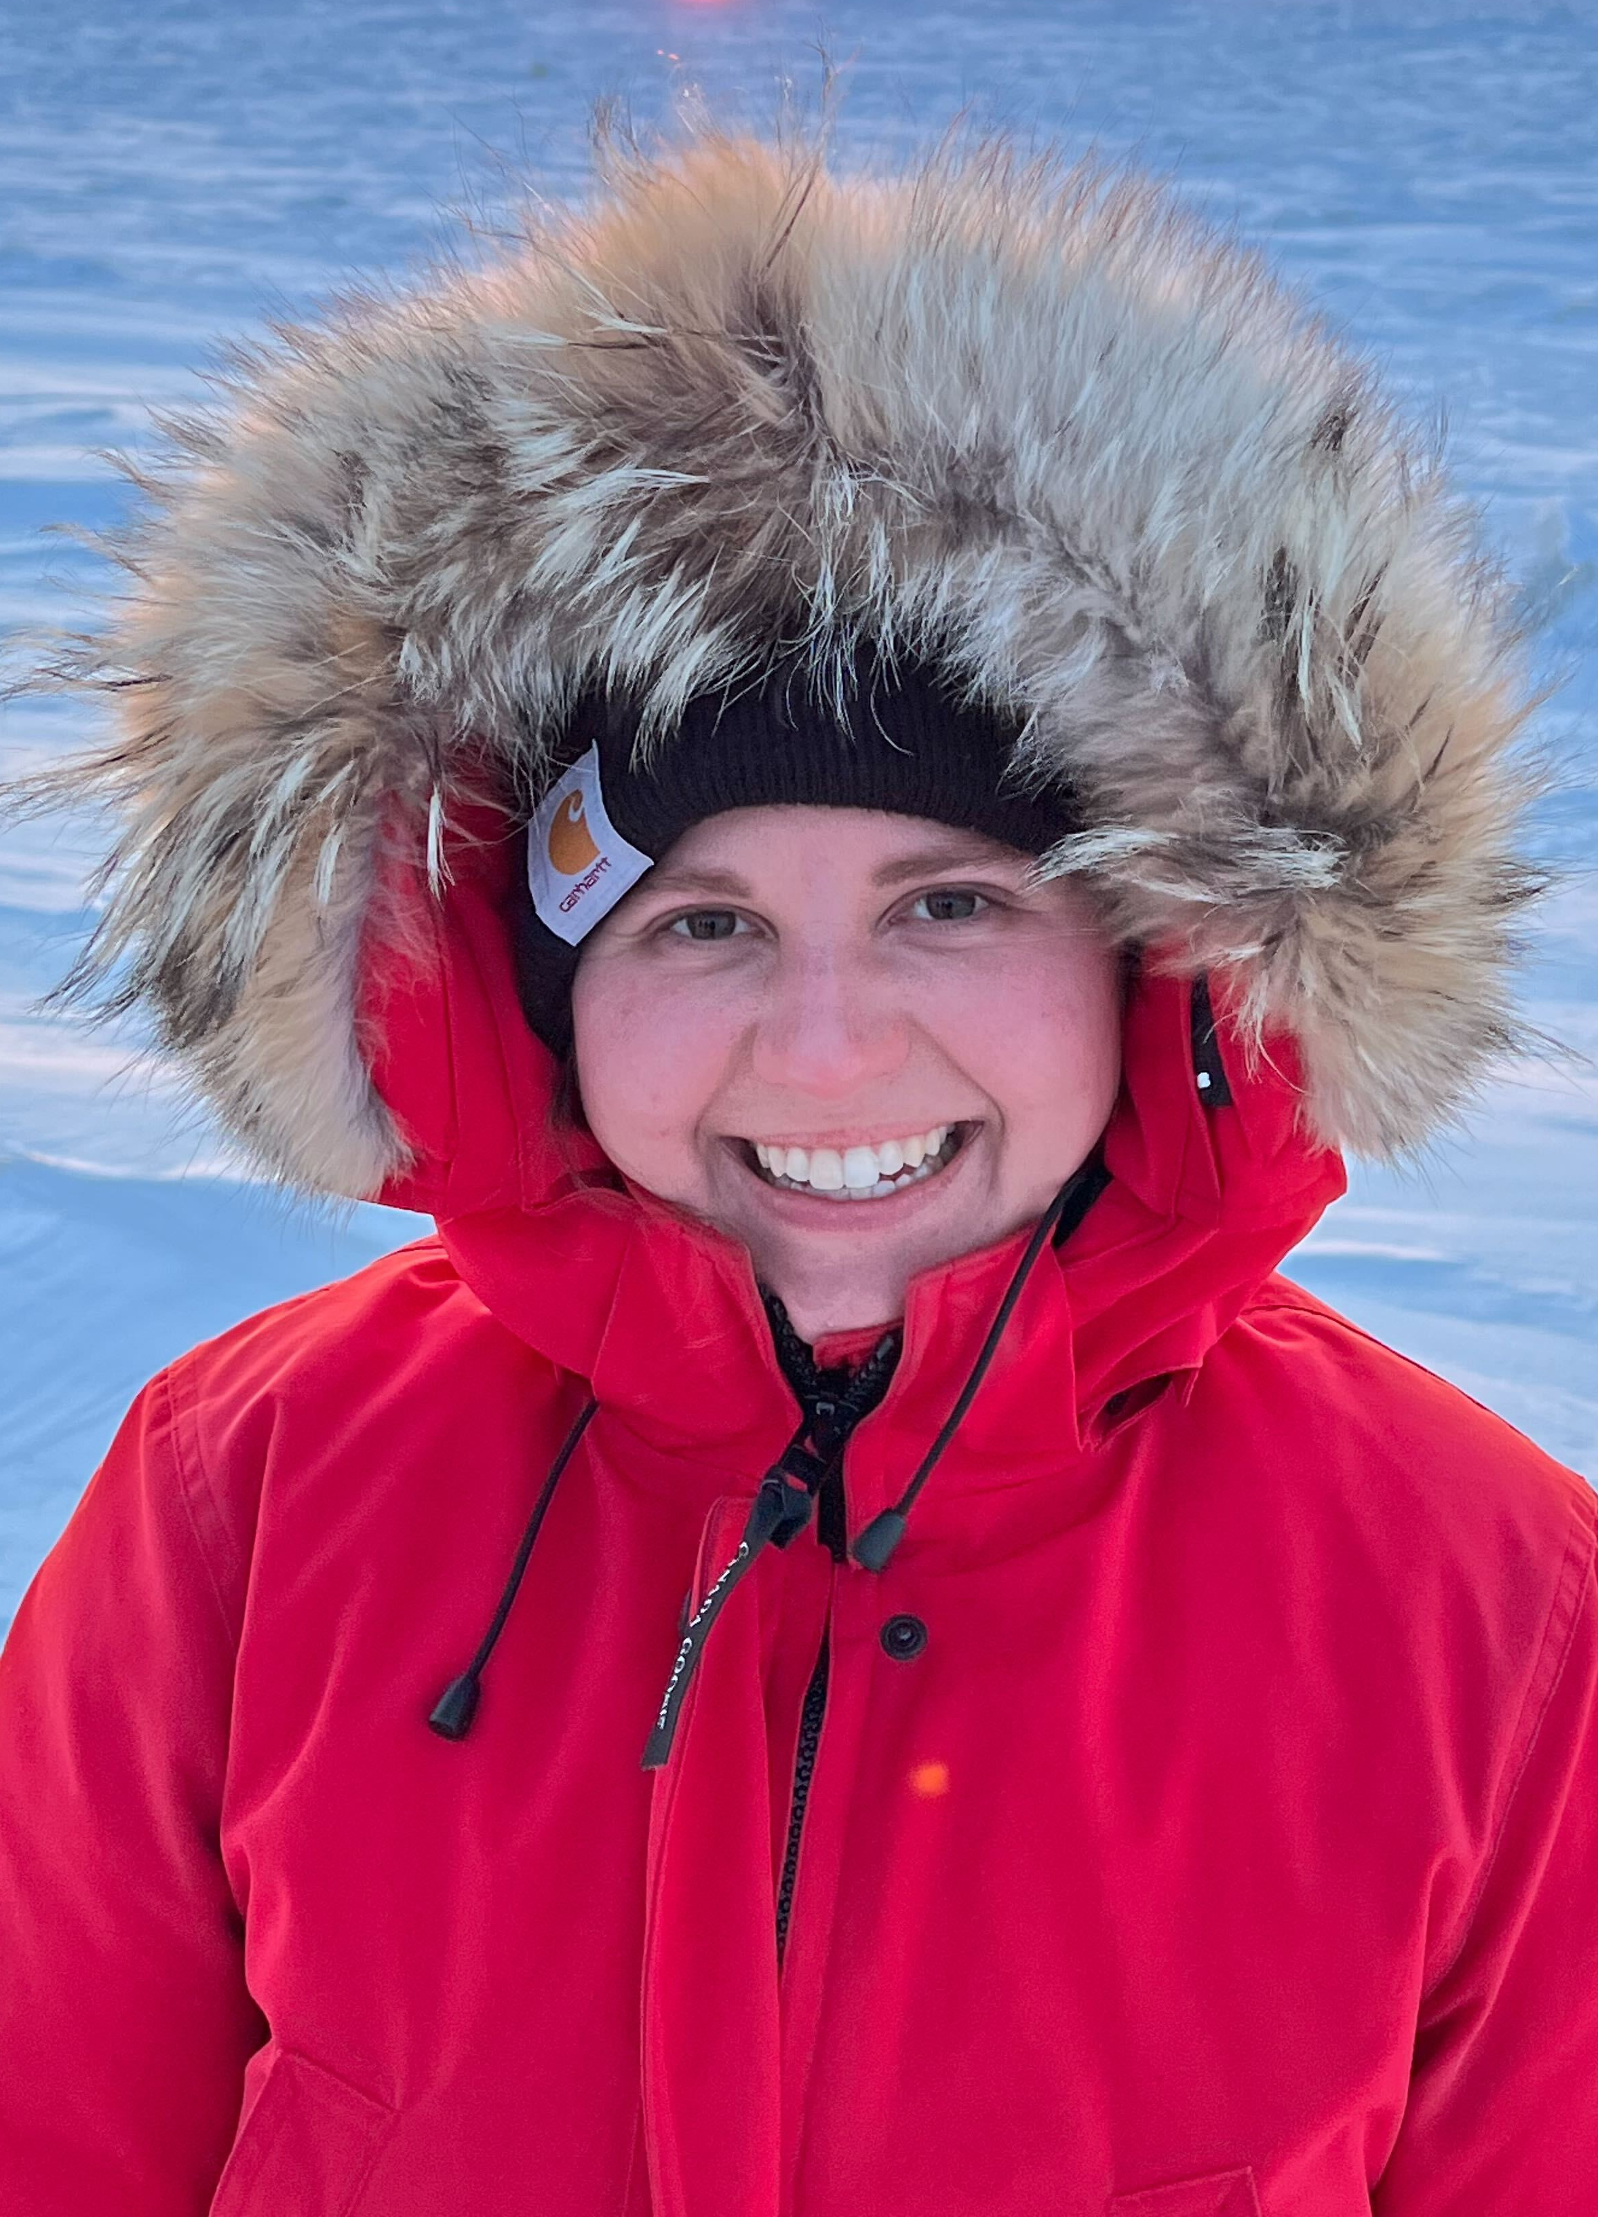
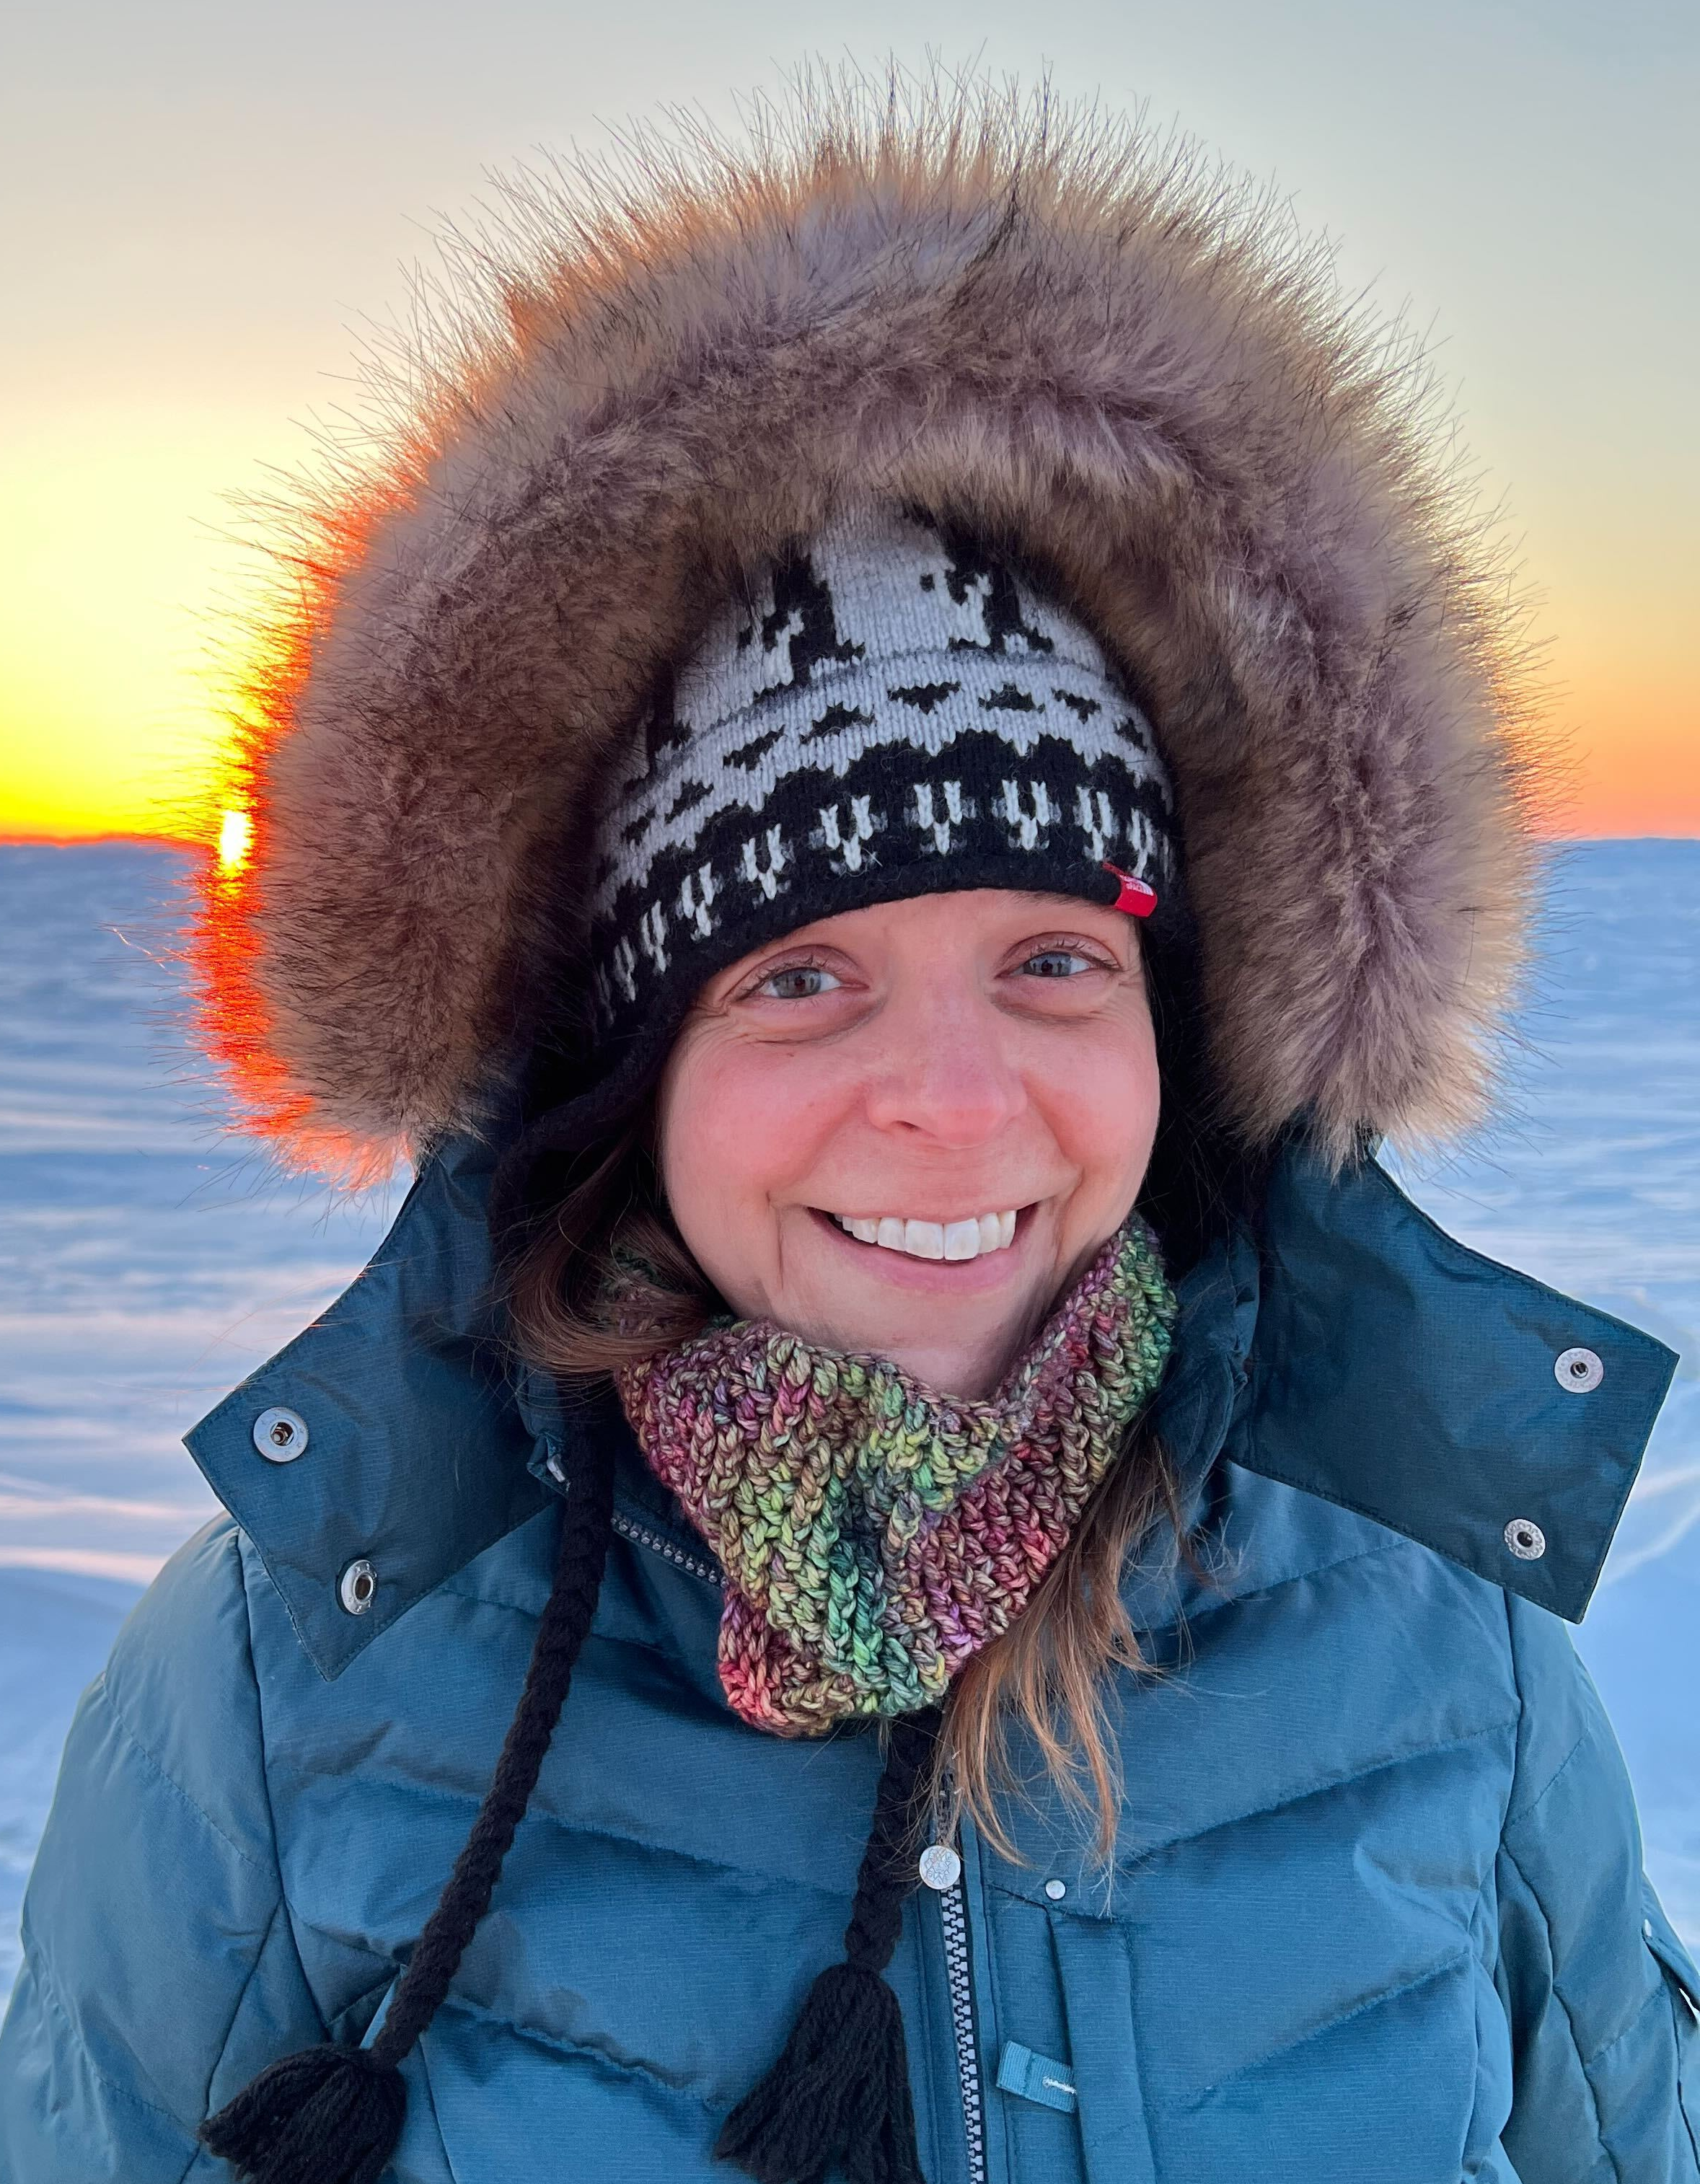
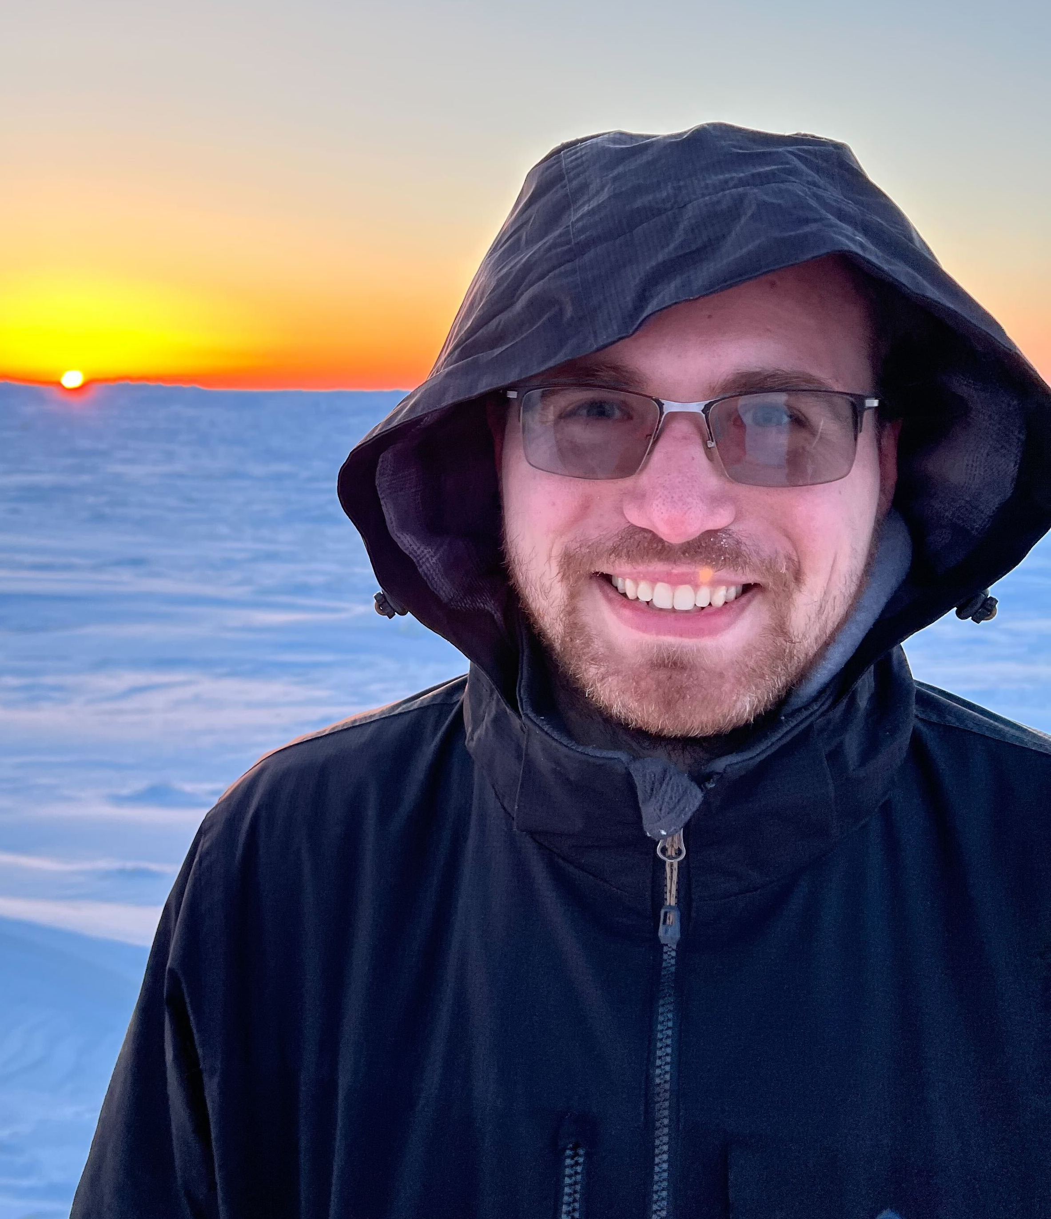
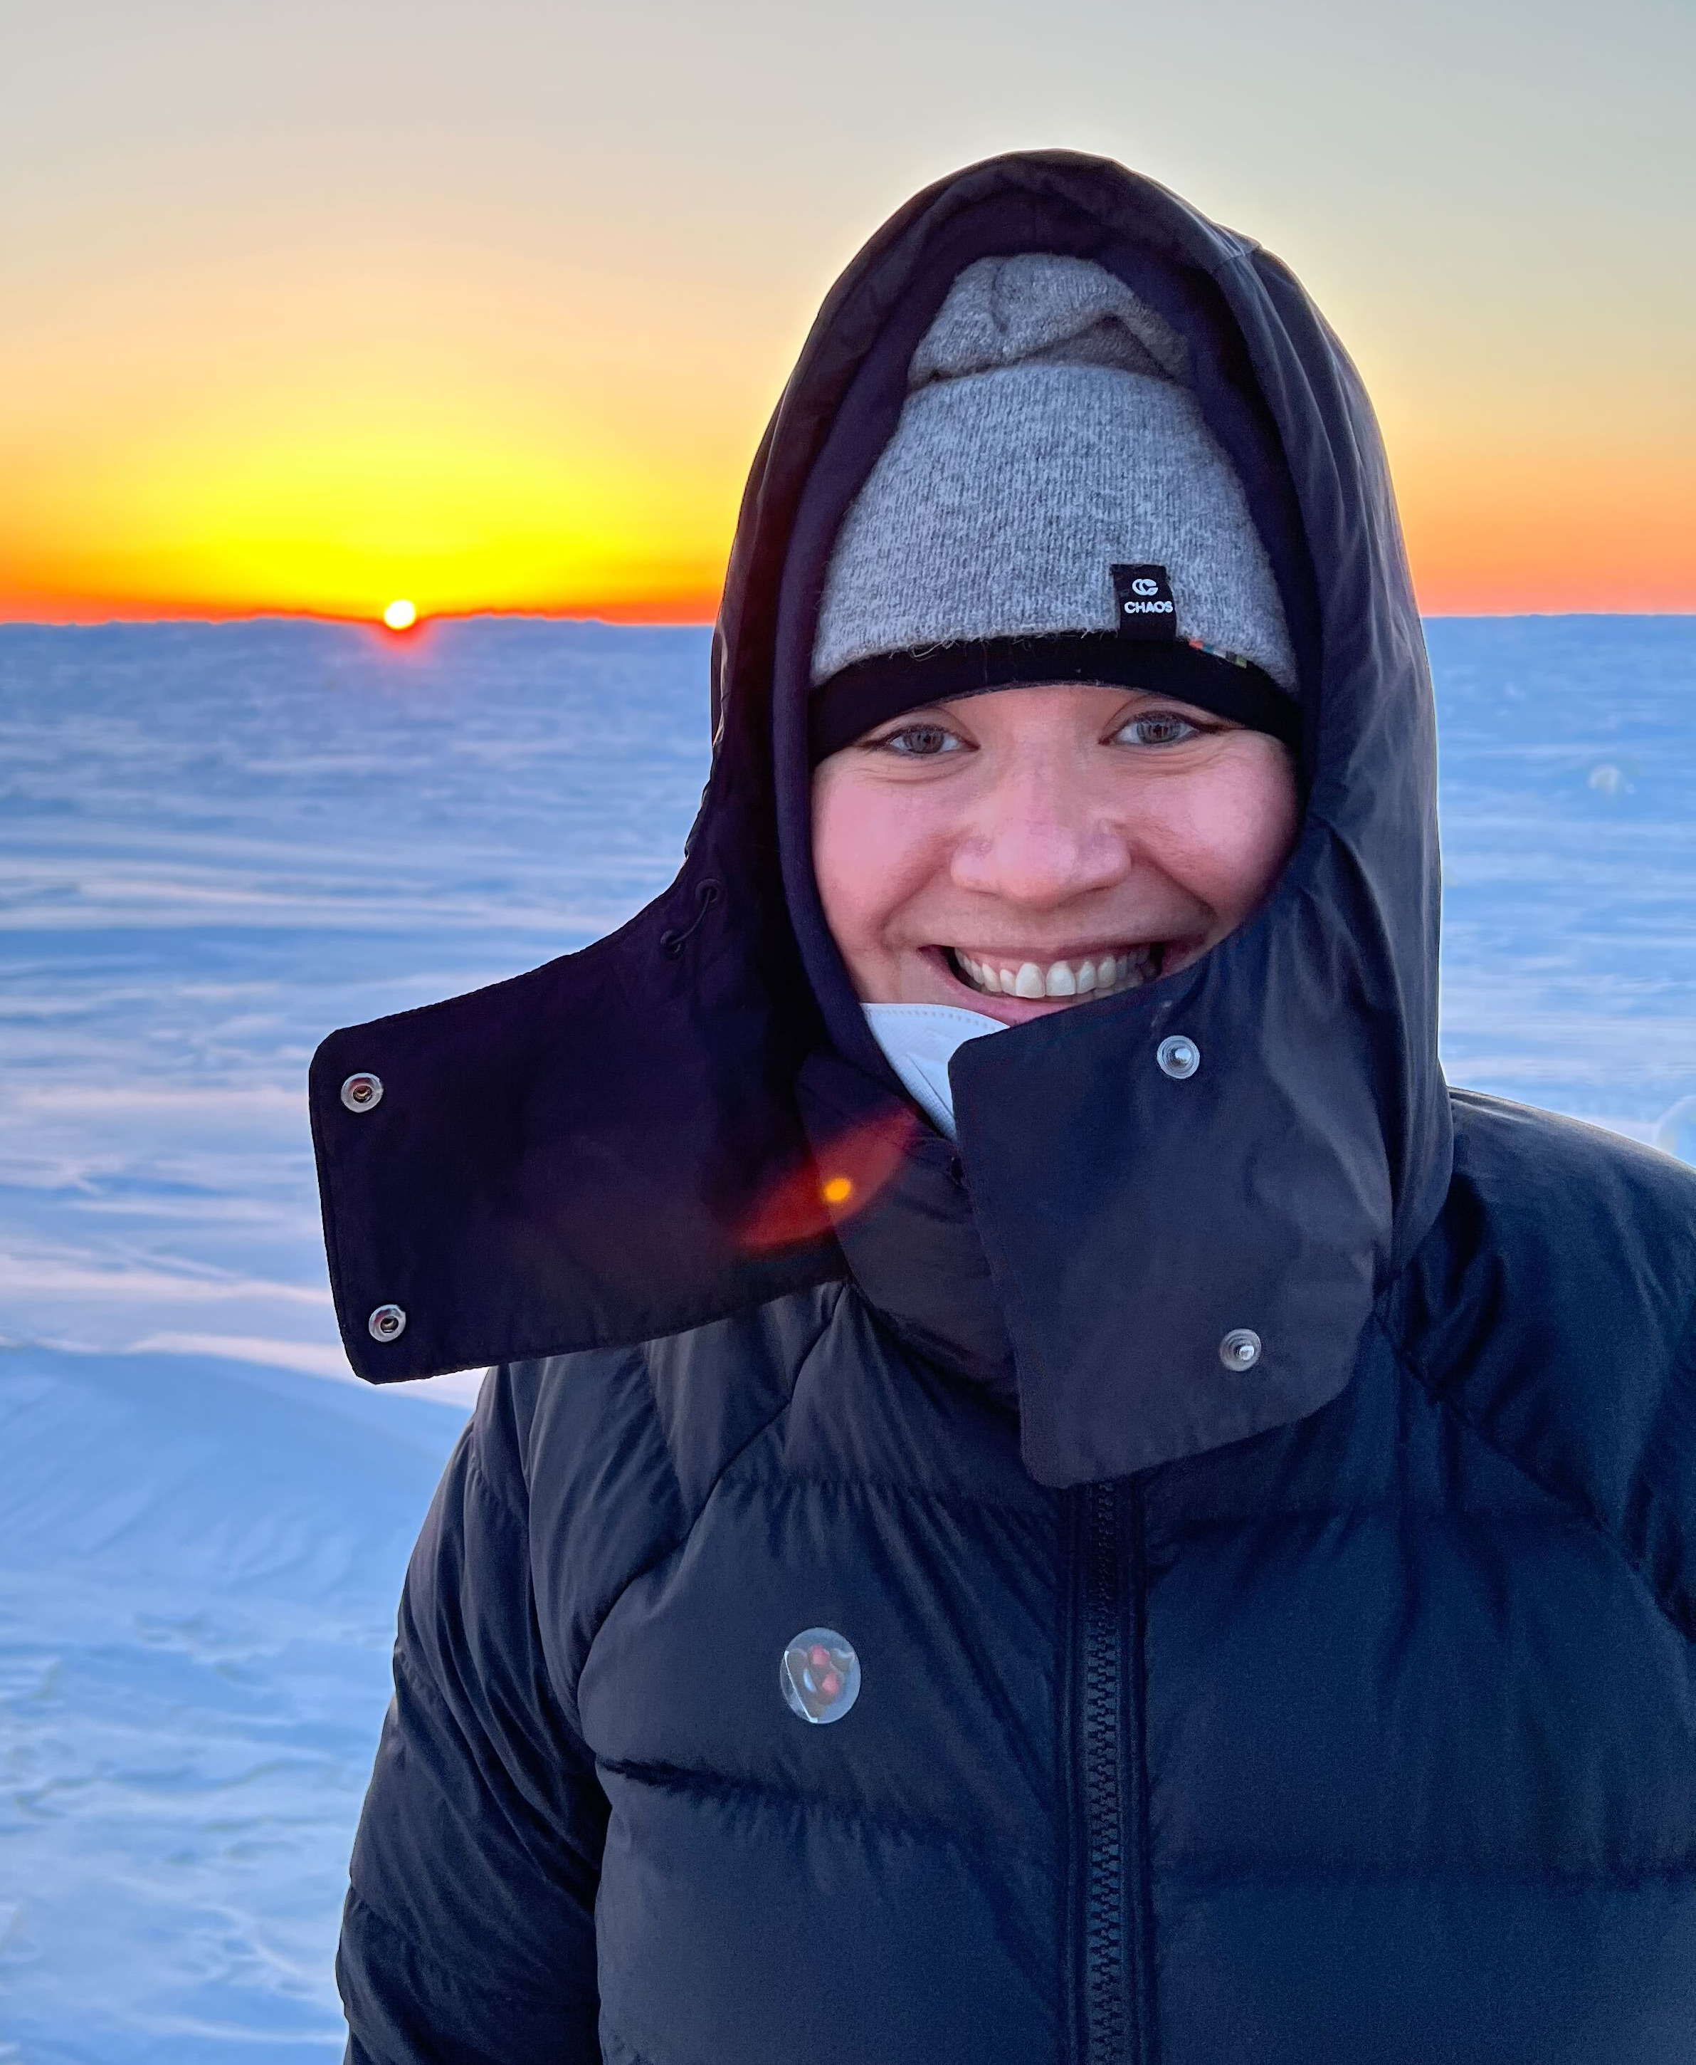
CHACHA: A Collaborative Research Project
Bill Simpson
Jose Fuentes
Kerri Pratt
Paul Shepson
Sara Lance
Project Principal Investigators:
Aaron Wang
Nathaniel
Brockway
Bob Kaeser
Daun Jeong
Natasha Garner
Sarah Woods
Kris Hajny
Andrea Corral
Most Valuable Players:

Slide 3
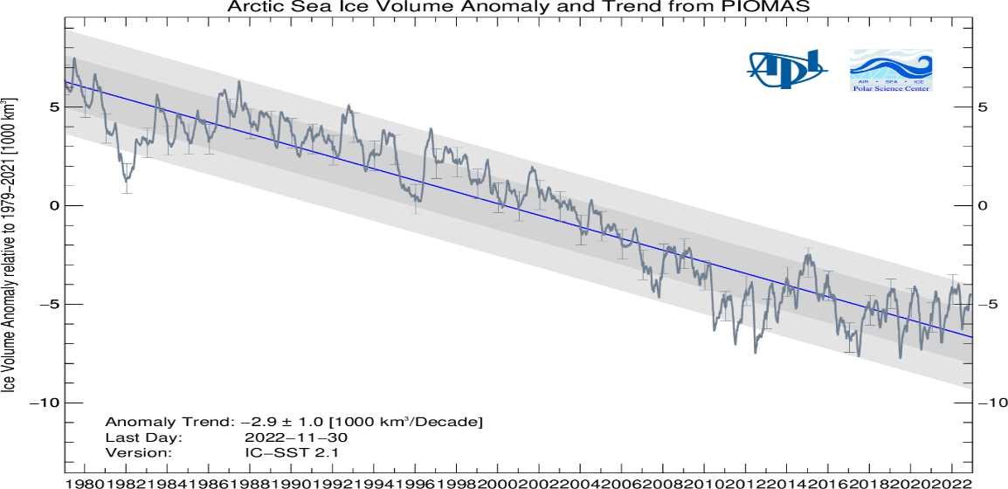
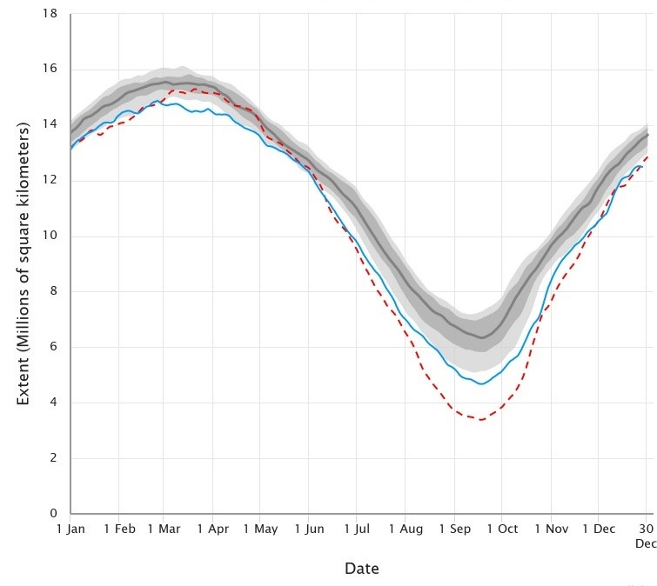
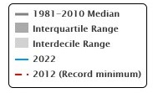
Chemistry in the Arctic: Clouds, Halogens, and Aerosols (CHACHA)
Arctic Sea Ice Volume Anomaly
The Arctic is warming faster than elsewhere on Earth, and the New Arctic is expected to experience:
Change in melt season, more open water, reduced multiyear ice
Enhanced sea spray production
Altered convection
Altered clouds
At the same time, emissions from oil and gas extraction in the Arctic continue and may increase in the future
Ice Volume Anomaly
relative to 1979-2021
1980
2000
2022
2
Arctic Sea Ice Extent
Extent (Millions of sq km)
1980-2020 median
1
Interquartile Range
Interdecile Range
2022
0
2012 (Record Min)
Jan
Apr
July
Oct
Dec

Slide 4
Chemistry in the Arctic: Clouds, Halogens, and Aerosols (CHACHA)
Arctic Sea Ice Volume Anomaly
The Arctic is warming faster than elsewhere on Earth, and the New Arctic is expected to experience:
Change in melt season, more open water, reduced multiyear ice
Enhanced sea spray production
Altered convection
Altered clouds
At the same time, emissions from oil and gas extraction in the Arctic continue and may increase in the future
Ice Volume Anomaly
relative to 1979-2021
CHACHA is designed to probe interactions between aerosol, clouds and halogens in the Arctic boundary layer, to better predict the atmospheric chemistry of the New Arctic.
Unique mix of natural and anthropogenic emissions provides test bed for evaluating broader understanding of halogen chemistry
1980
2000
2022
2
Arctic Sea Ice Extent
Extent (Millions of sq km)
1
0
Jan
Apr
July
Oct
Dec

Slide 5
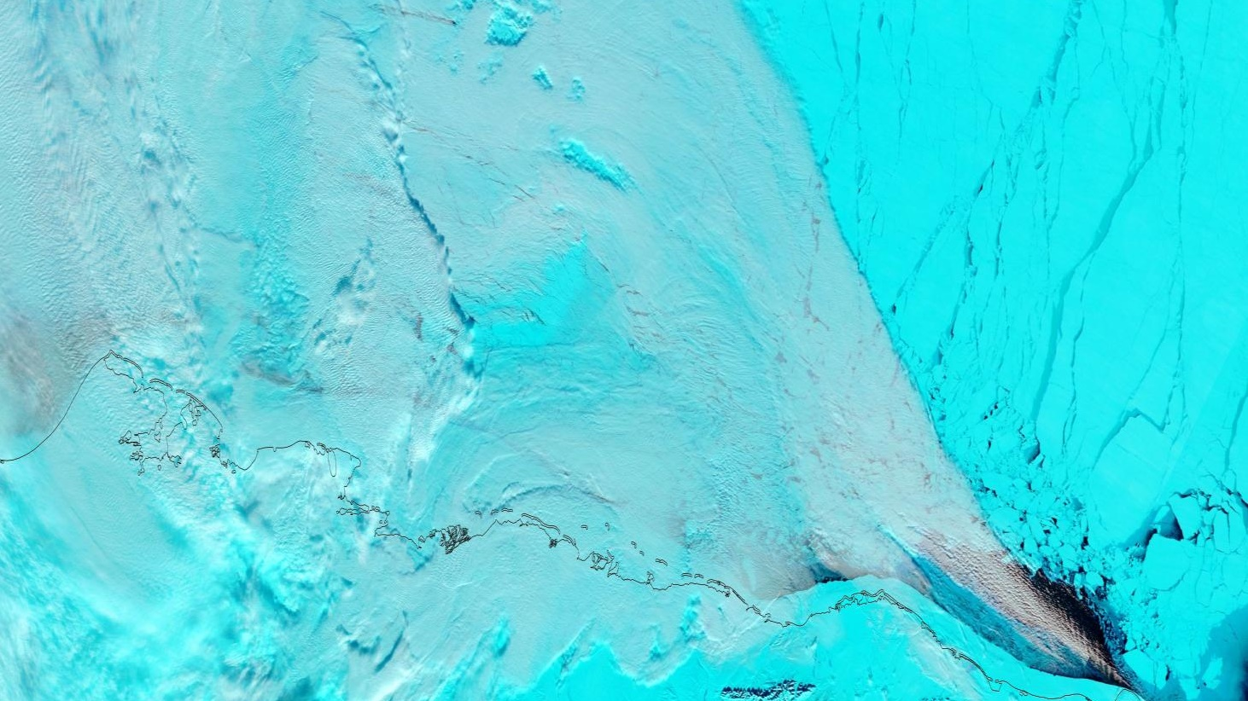
Mixed-phase boundary layer cloud microphysics
Very few in-situ microphysics measurements of boundary layer clouds specifically associated with Arctic leads (cracks in the sea ice)
CHACHA = most comprehensive dataset since 1998 FIRE.ACE [Gultepe et al., 2001]. Cloud microphysics instruments have improved substantially since then.
CHACHA provided the first opportunity to probe the chemical composition of Arctic lead clouds
Cloud droplets sampled with a CVI inlet to probe heterogeneous halogen chemical processing.
While 2008 ISDAC project used single particle mass spec behind a CVI, lead clouds were not specifically targeted or identified
Terra, MODIS 7-2-1, accentuates contrast between sea ice and clouds (image from Feb 27, 2022)
Notes:
(sample volume, image resolution and ice shatter artifacts have all improved). Challenge of sampling Arctic lead clouds – very low over the ocean surface.

Slide 6
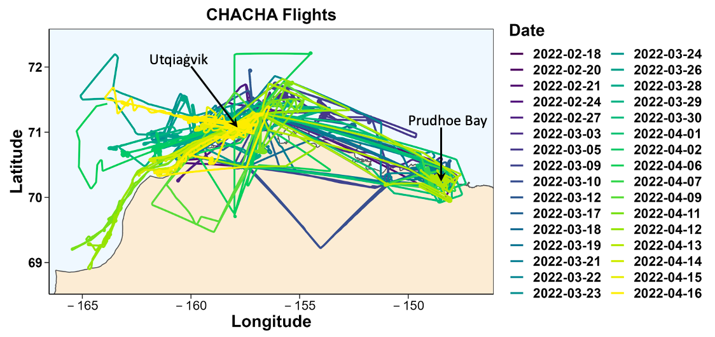
Beaufort Sea
Chukchi
61 Total Flights
27 ALAR Flights
34 King Air Flights

Slide 7
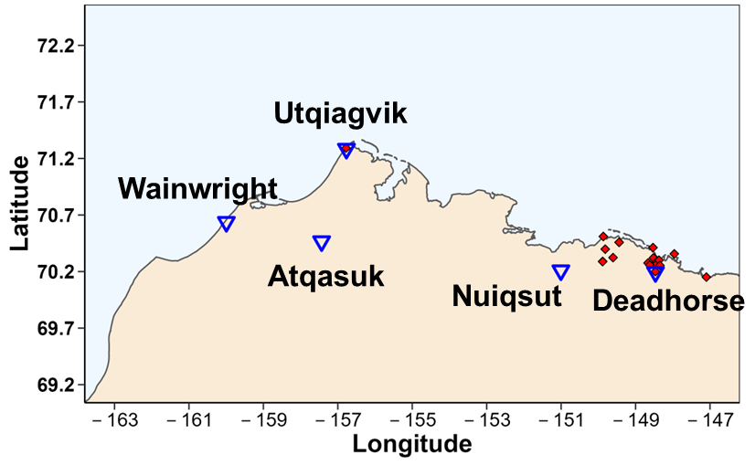
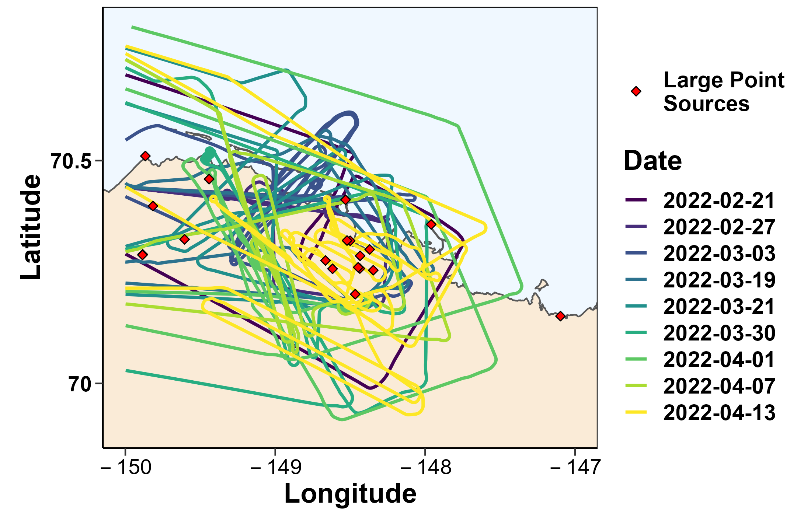
Prudhoe Bay Flights (UWyo King Air and ALAR)
Chukchi
Beaufort Sea
Goals:
Quantify greenhouse gas and NOx emissions from Prudhoe Bay
Evaluate impact of Oil and Gas emissions on halogen chemistry

Slide 8
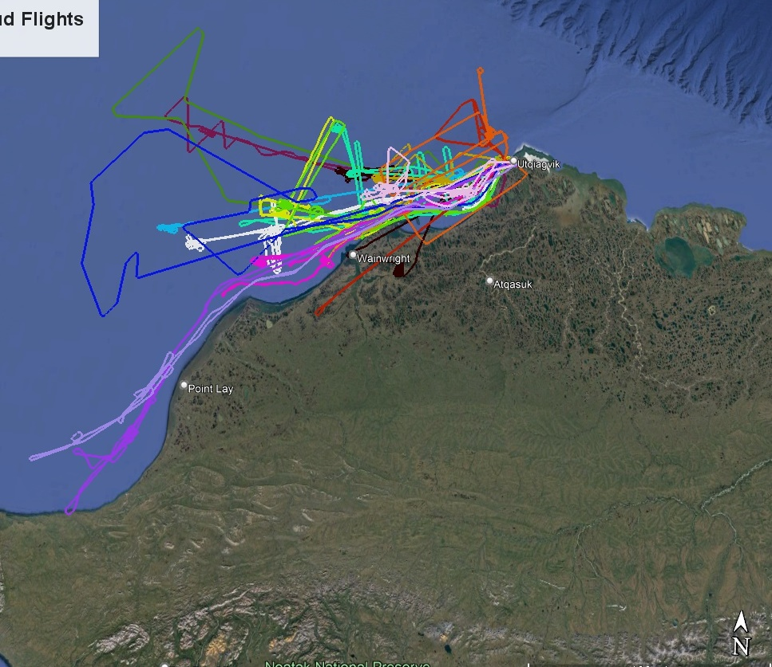
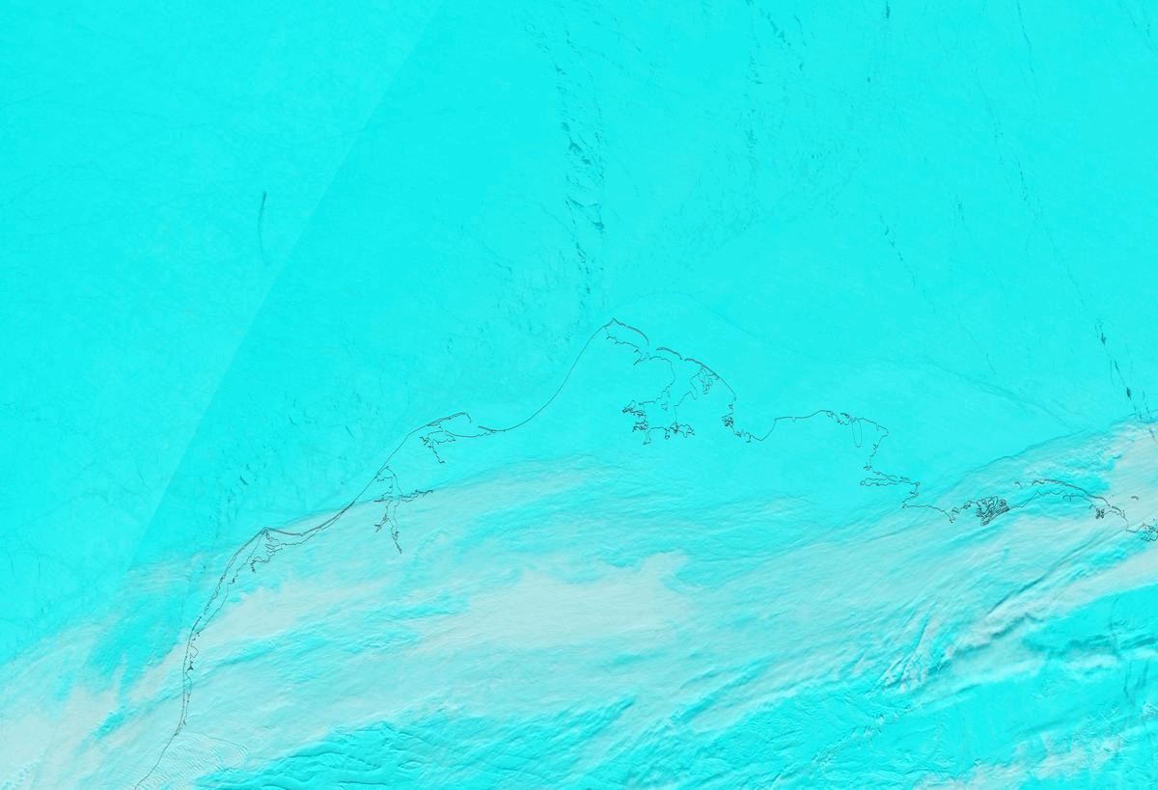
16 King Air Lead Cloud Flights
Increasing sea spray emissions are expected to increase heterogeneous reactions:
both while airborne, and
upon deposition to the snowpack
Beaufort Sea
Chukchi
Utqiaġvik Lead: MODIS Time Lapse March 16 – April 4, 2022
Terra, MODIS 7-2-1
Notes:
Lead cloud flight focused on the Chukchi. Can clearly see the effect of the winds pushing the ice away from the shore and exposing the water to the atmosphere. The sea ice and clouds forming here were more predictable day to day than any leads forming in the Beaufort sea, but we did have situations where lead clouds developed upwind of Utqiagvik in the Beaufort sea, preventing us from taking off.

Slide 9
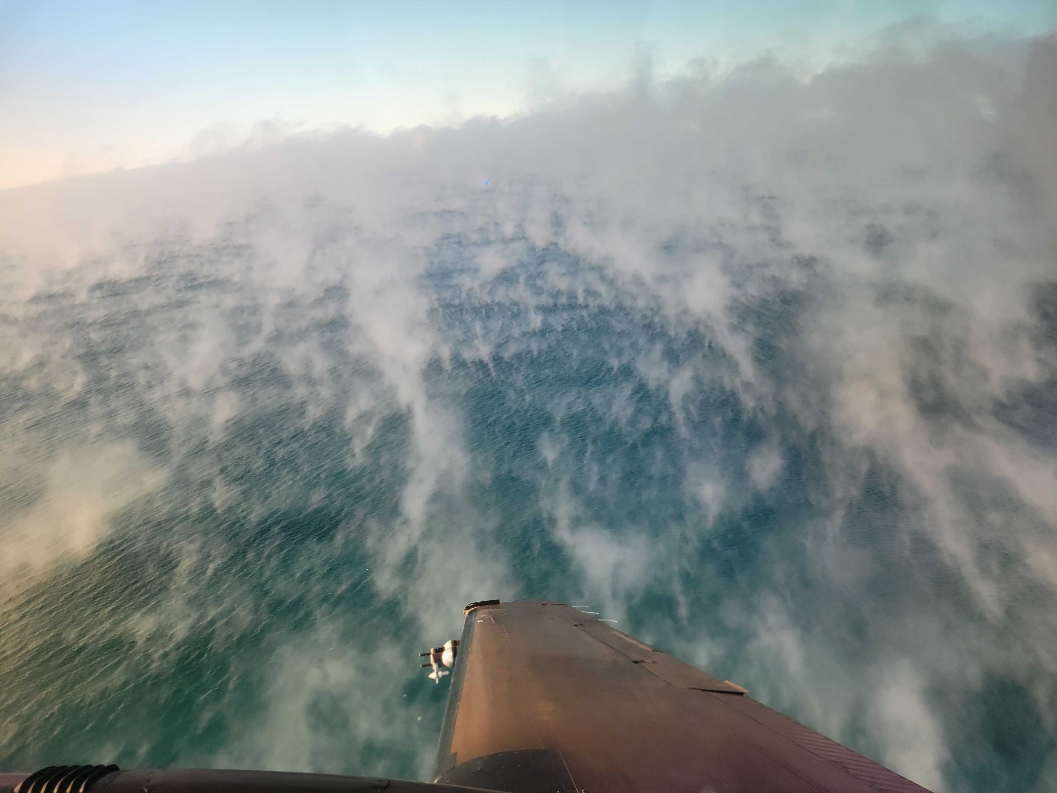
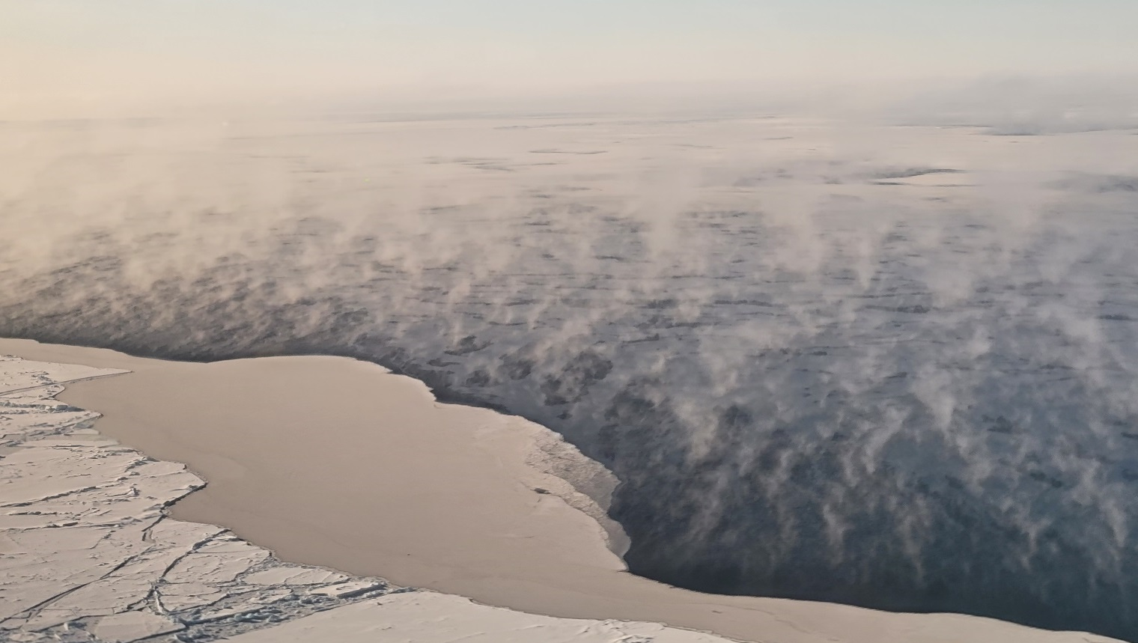
Targeting clouds forming from leads
Photo credit: Sarah Woods
We were able to visually connect the “sea smoke” emanating from the surface of the open water to the clouds forming downwind and overhead
Photo credit: Sarah Woods
White caps were observed on the surface of large openings in the sea ice, suggesting active sea spray production
Notes:
Sarah was actually the flight scientist onboard all the lead cloud flights, directing the King Air pilots to the clouds of interest.

Slide 10
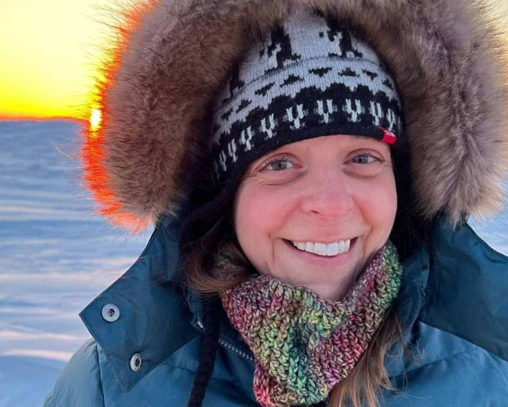
Targeting clouds forming from leads
Photo credit: Sarah Woods
We were able to visually connect the “sea smoke” emanating from the surface of the open water to the clouds forming downwind and overhead
Photo credit: Sarah Woods
White caps were observed on the surface of large openings in the sea ice, suggesting active sea spray production
11A.3: Arctic Lead Cloud Microphysics Observed during CHACHA (Invited)
2:00-2:15 PM
Wednesday (Room 502)
Sarah Woods
Notes:
Sarah was actually the flight scientist onboard all the lead cloud flights, directing the King Air pilots to the clouds of interest.

Slide 11
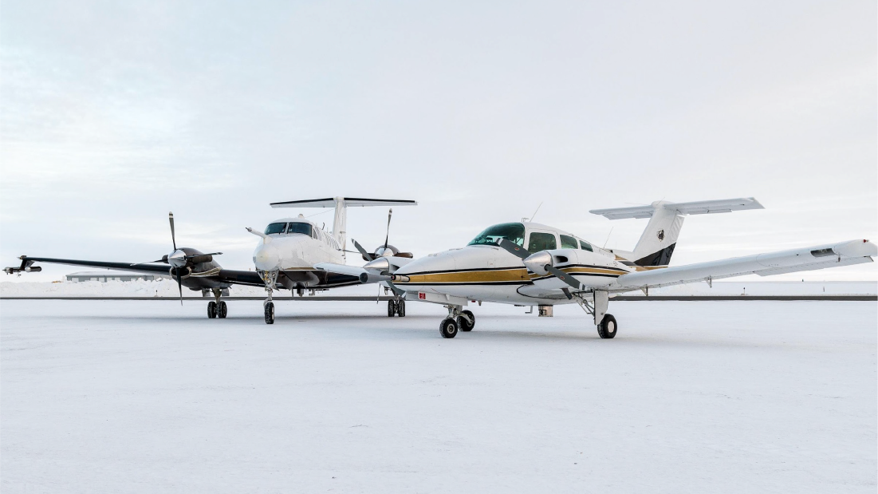
CHACHA Airborne Measurement Suite
ALAR
Remotely sensed BrO and NO₂ (AMAX-DOAS)
Gas phase pollutants (CO₂, Methane, Ozone, NO₂)
Aerosol size distribution (OPC)
Photo Credit : Chris Rodgers
King-Air
Cloud droplet residual chemical composition (CVI with PILS + DRUM)
Aerosol chemical composition and size distribution (PILS, DRUM, CPC, POPS, PCASP)
Cloud microphysics (CDP, 2D-S)
Reactive gas phase chemical speciation (Ozone 2B, CIMS)
Vertical profiles of wind, humidity & temperature to the surface (dropsondes)
Upwelling and downwelling radiation

Slide 12
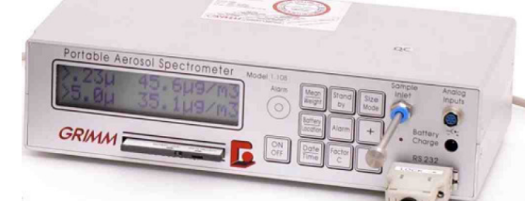
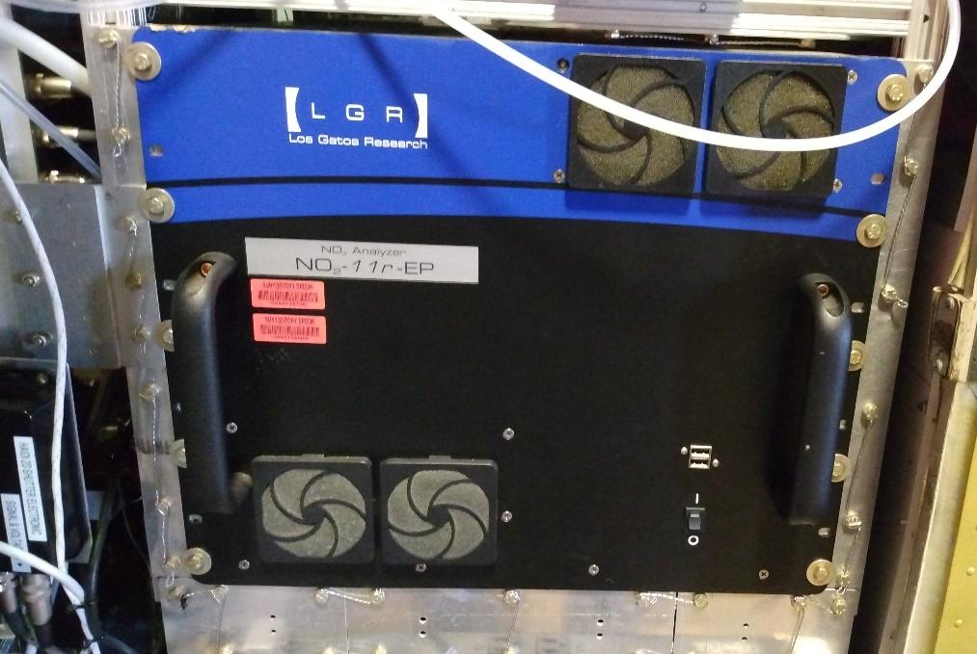
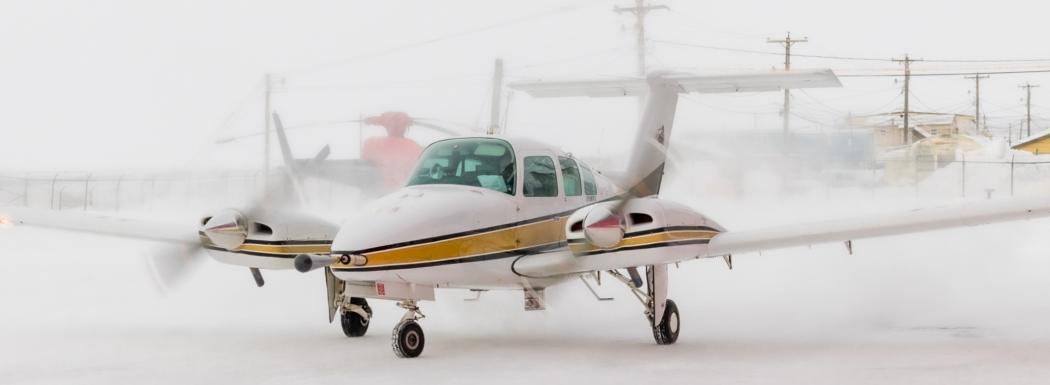
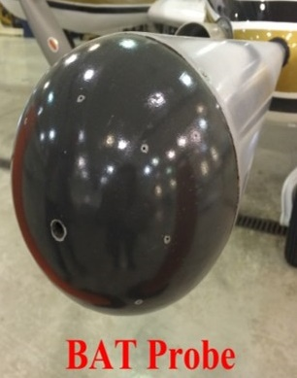
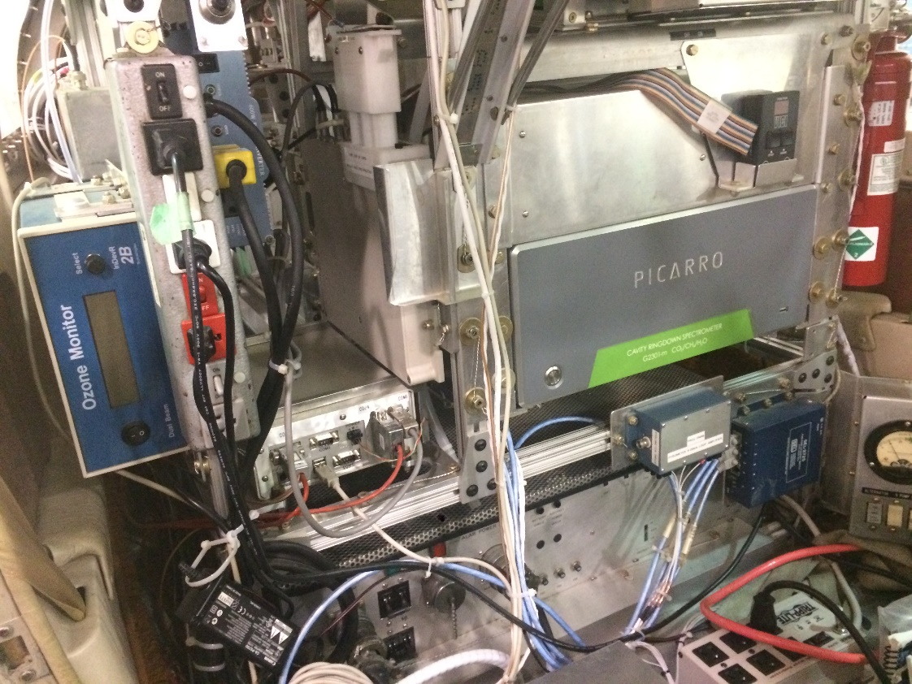
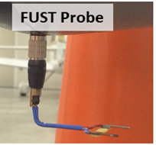
Airborne Laboratory for Atmospheric Research (ALAR)
Radiometer
GRIMM aerosol spectrometer
Photo Credit : Chris Rodgers
LGR NO₂ Analyzer
Photo Credit : Jay Tomlin
Picarro CRDS
2B O3 Monitor
Heidelberg Airborne Imaging DOAS Instrument (HAIDI)

Slide 13
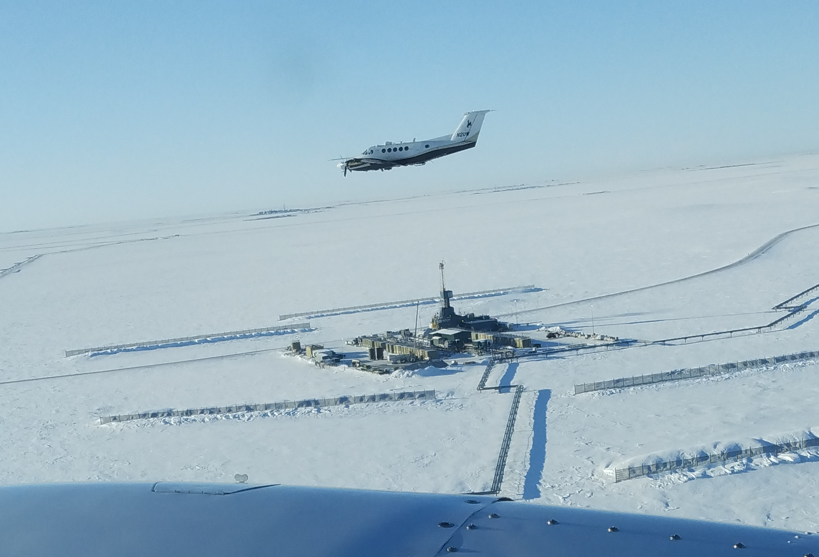
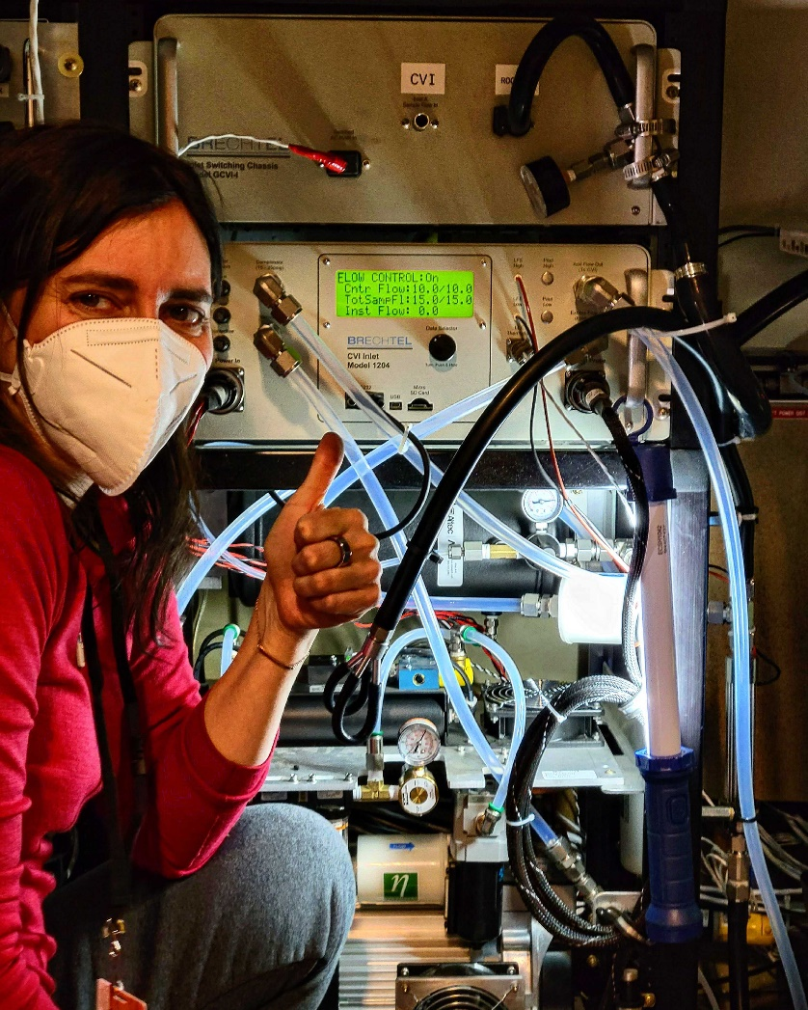
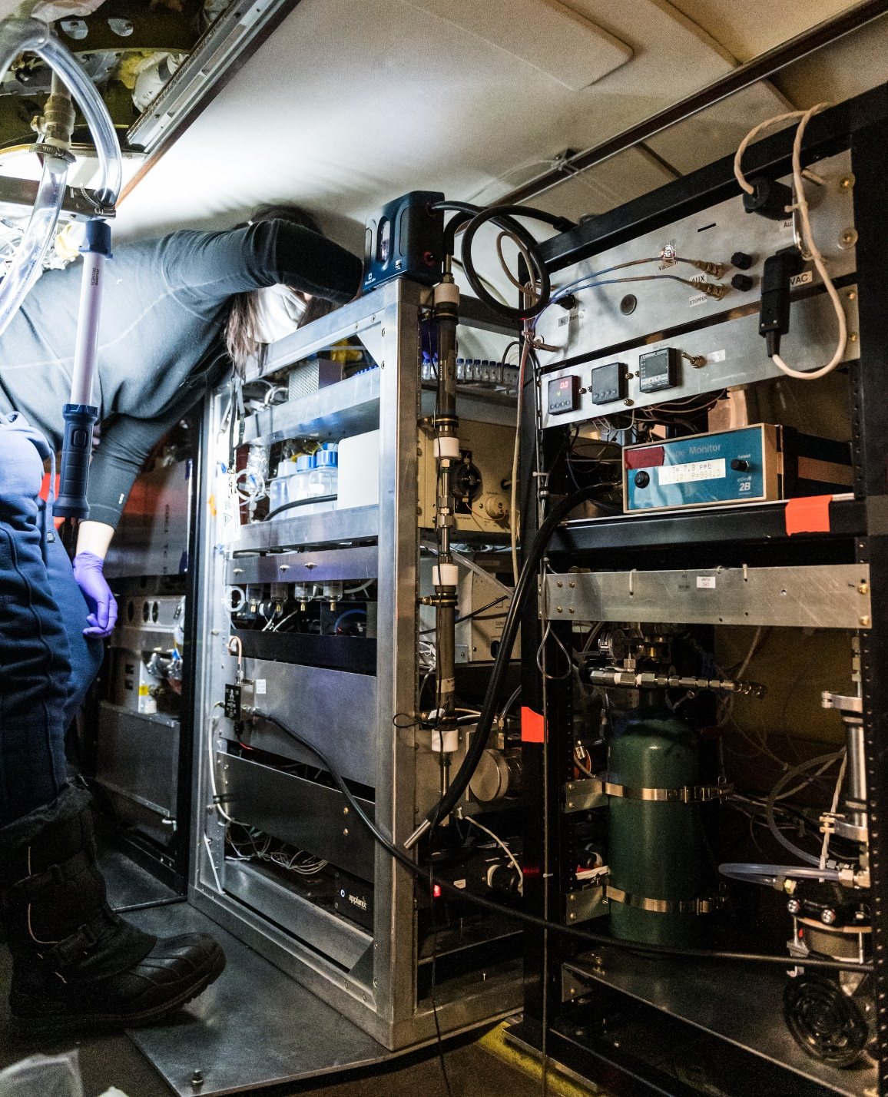
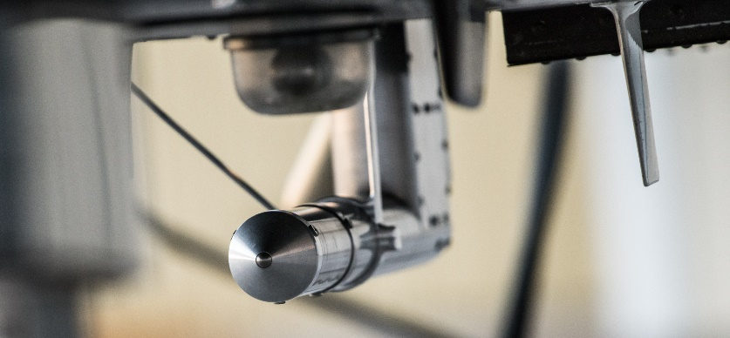
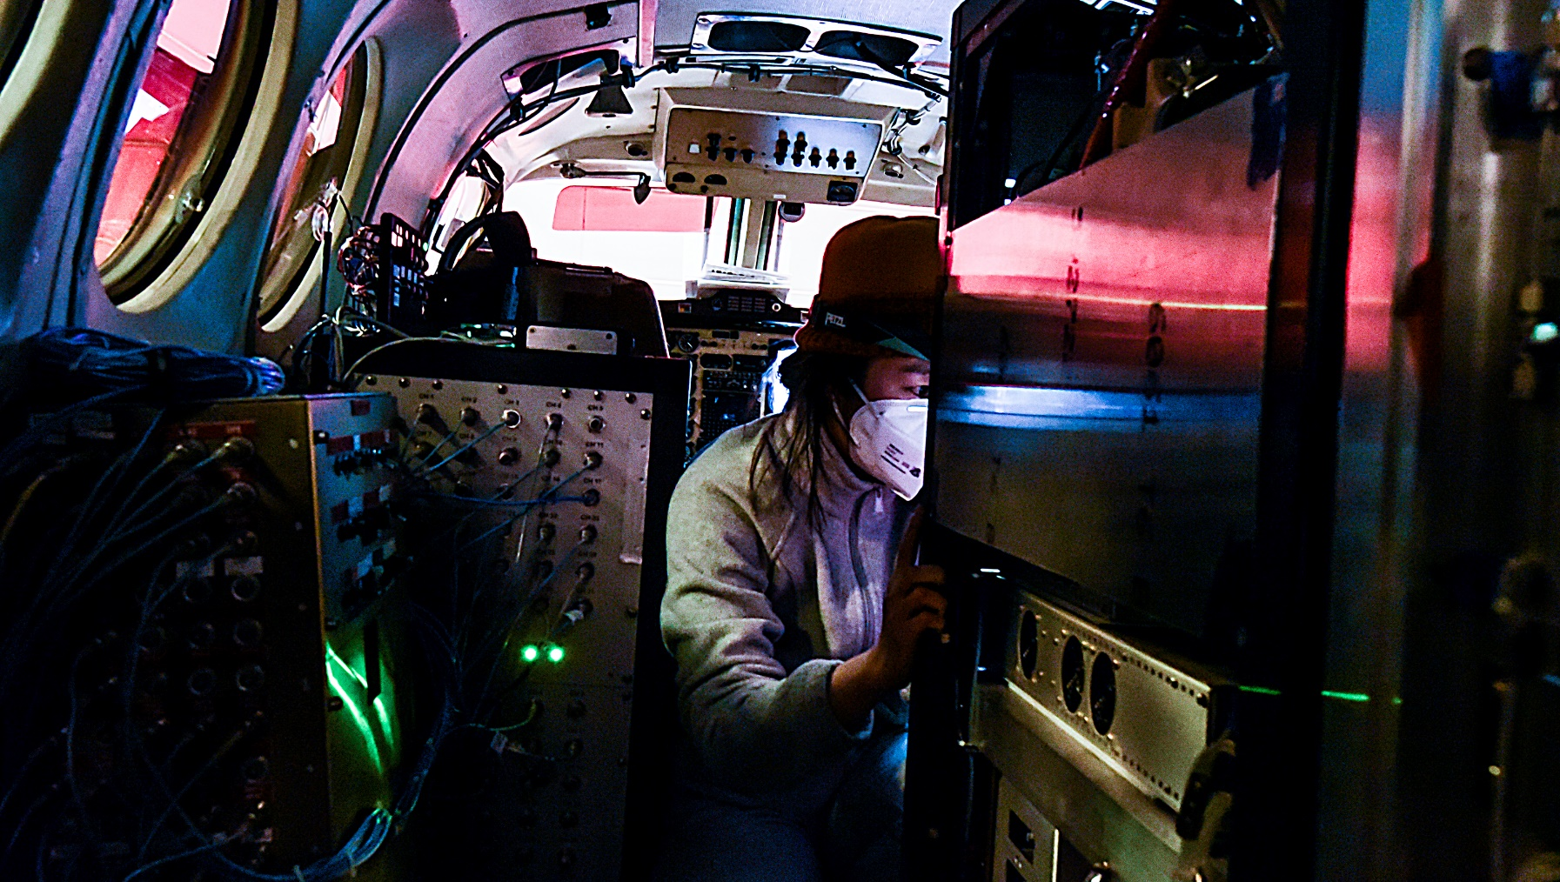
University of WY King Air
CVI controller
DRUM
PILS
Final project for the KA
Unique payload
Mix of microphysical and chemical instruments (gas, aerosol and cloud phases)
Only project where a CVI has been used onboard the King Air
Power limitations resulted in “Cloud flights” with CIMS off, and “CIMS flights” with CVI off
O₃
Photo Credit: Chris Rodgers
CVI inlet
Photo Credit: Chris Rodgers
CIMS
Photo Credit : Kris Hajny
Photo Credit: Chris Rodgers
Notes:
Unique and challenging

Slide 14
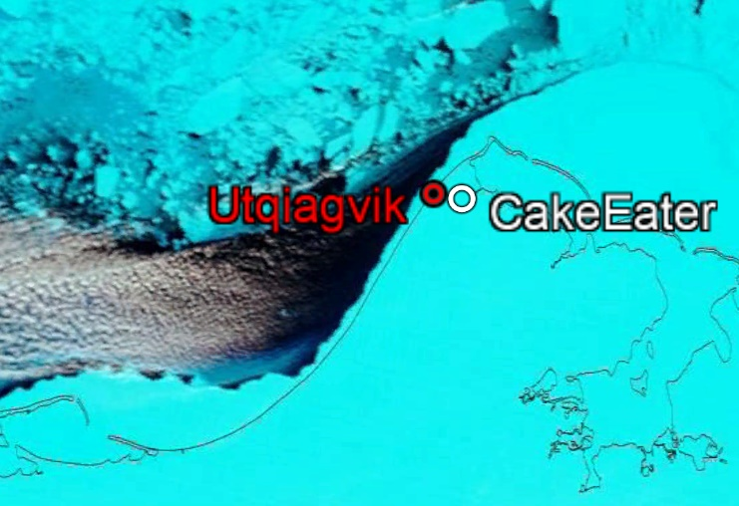
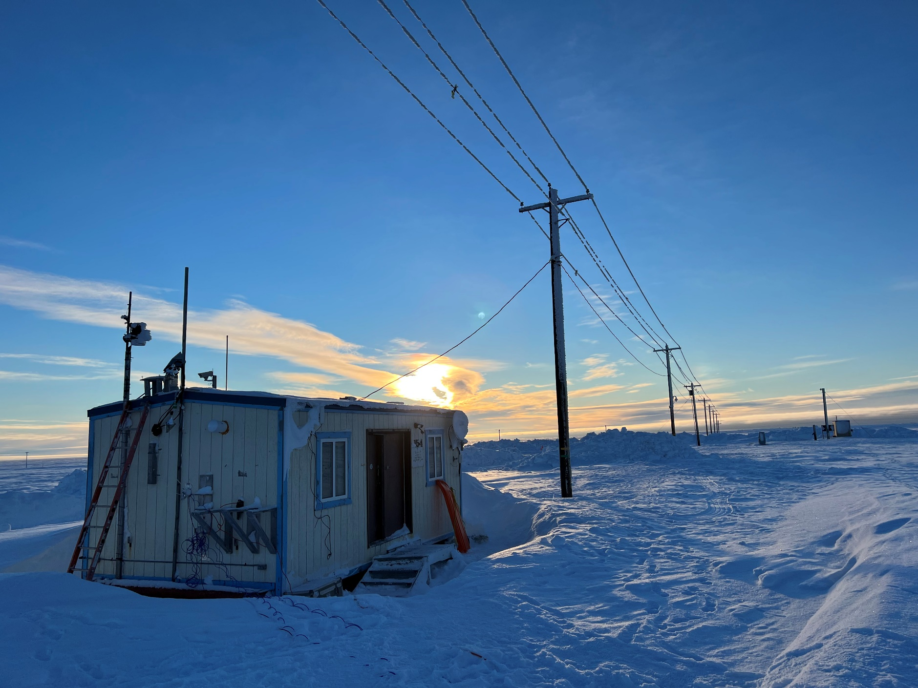
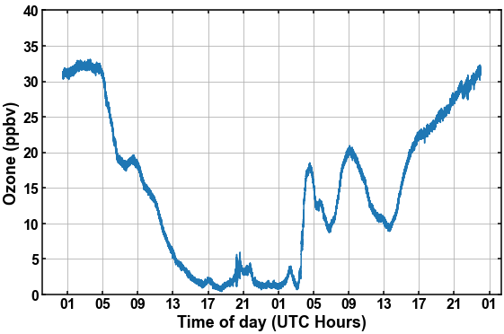
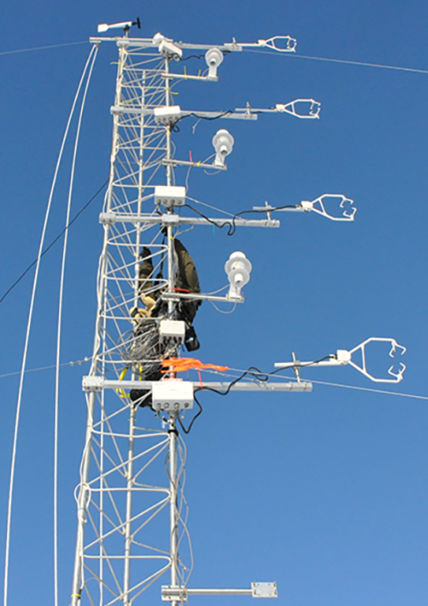
Continuous Observations on the Tundra
Surface-based measurements:
Ozone
Aerosol chemical composition + size
Snow composition
Cake Eater site
Ozone Depletion event
12m Tower Measurements:
Air turbulence at eight levels
Incoming and outgoing solar irradiance
Incoming and outgoing terrestrial irradiance
Air temperature at six levels
Air humidity at two levels
Wind speed and direction
Atmospheric pressure
Mar 31, 2022
Notes:
"A key consequence of reactive halogen chemistry is the reaction of Br radicals with O3 to produce BrO, which we detect. This reaction depletes ozone, often completely, altering the oxidation chemistry of the Arctic substantially. We know that BrO recycles back to Br radicals. There are many photochemical recycling pathways, and our work is studying them. Additionally, fresh pollution (e.g. NOx) interacts with the recycling, which is another key aspect we are studying."

Slide 15
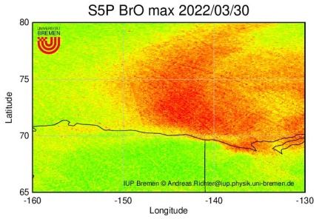
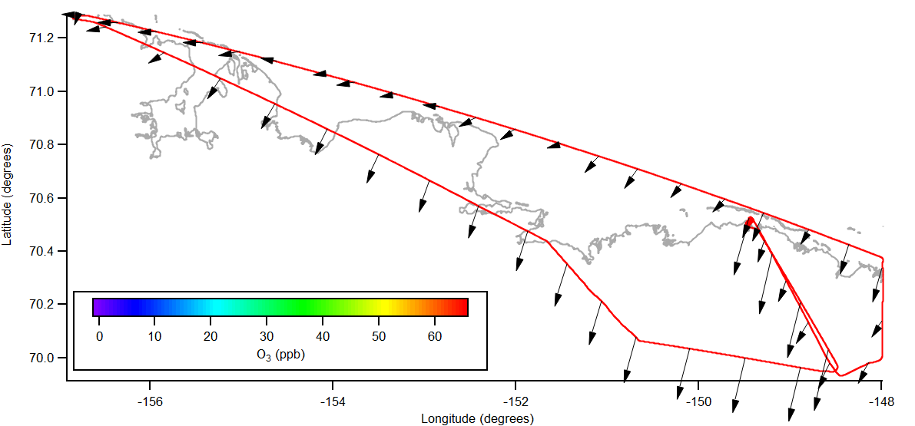
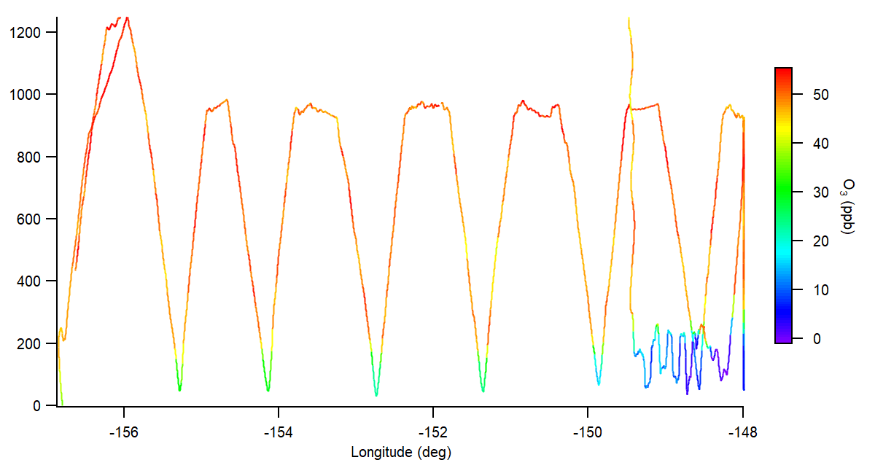
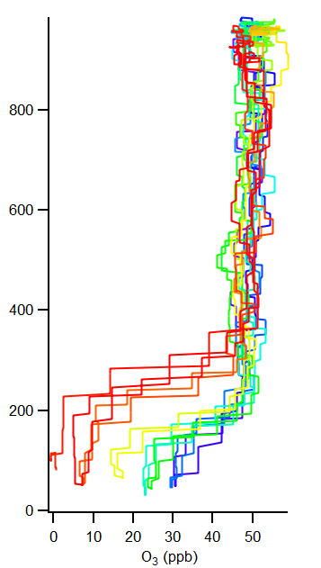
Ozone Depletion associated with Regional BrO Gradient
Utqiagvik
Latitude (deg)
Prudhoe Bay
O₃ vertical profiles along the AK North Slope (upwind of Prudhoe Bay)
In-situ data shows ODE in the East, where BrO is large according to Tropomi total column BrO on March 30
O₃ (ppb)
Height (m agl)
O₃ (ppb)
Longitude (deg)

Slide 16
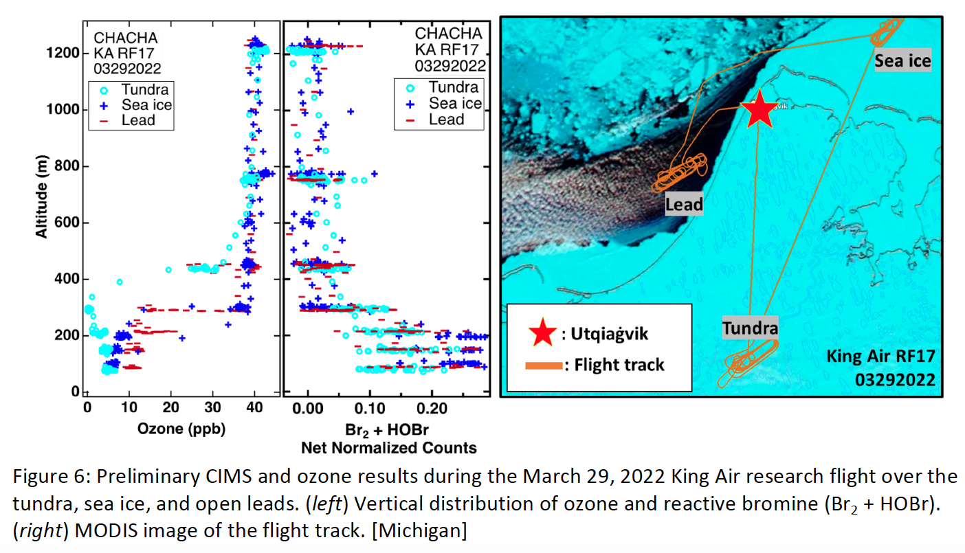
wind
Figure 2.
Notes:
Vertical profiles driven by thermodynamics /turbulence

Slide 17
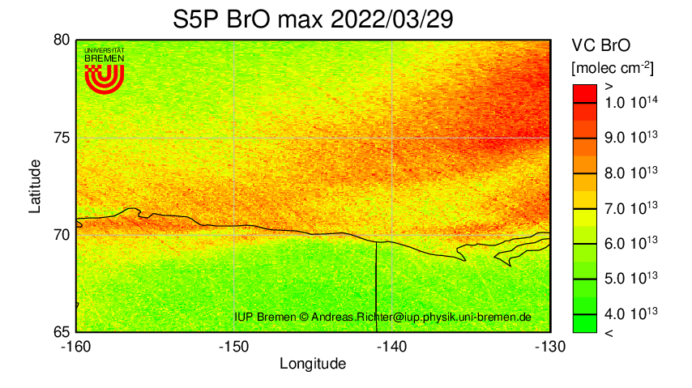
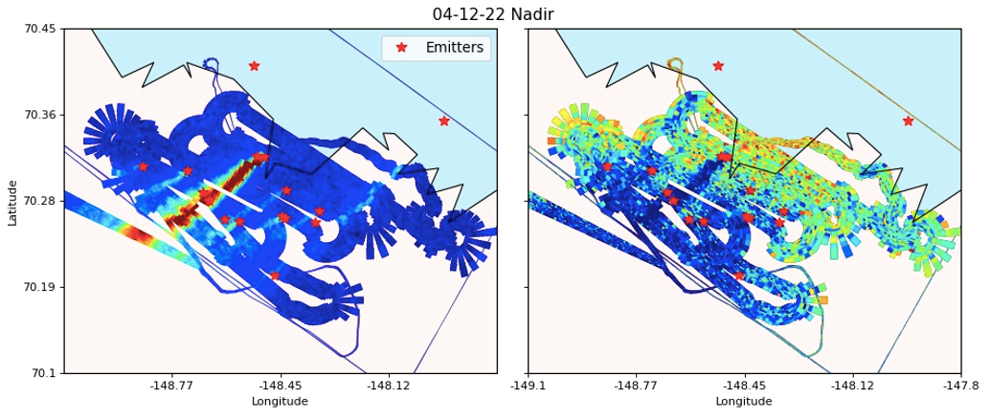
Impact of Oil & Gas Extraction on Bromine Chemistry
In high NOx environments, BrO is depleted in the near-field, but satellite observations lack information on the vertical structure
HAIDI detected NO₂ and depletion of BrO in the vicinity of the Prudhoe Bay oil field industrial facilities as mapped by the nadir scanner on April 12, 2022. The red star symbols represent oil field facilities.

Slide 18
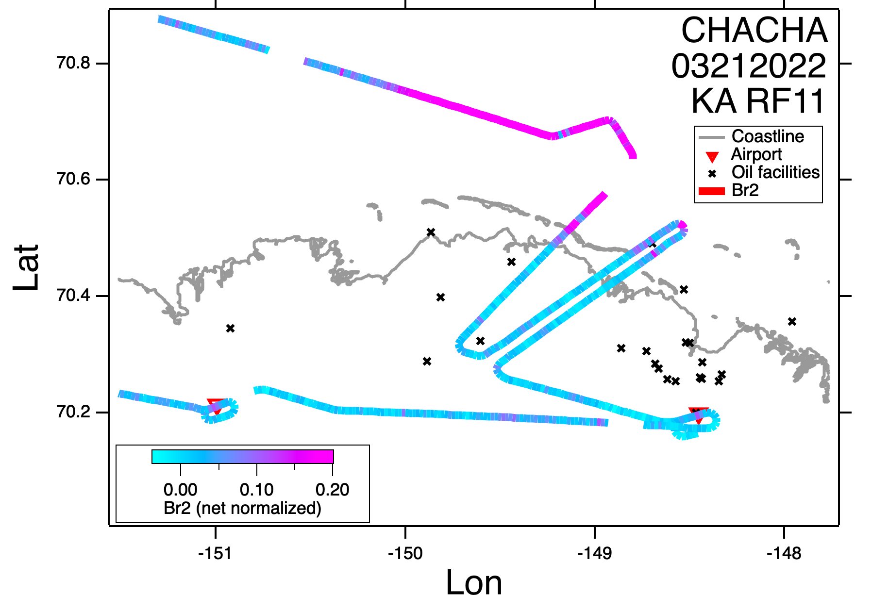
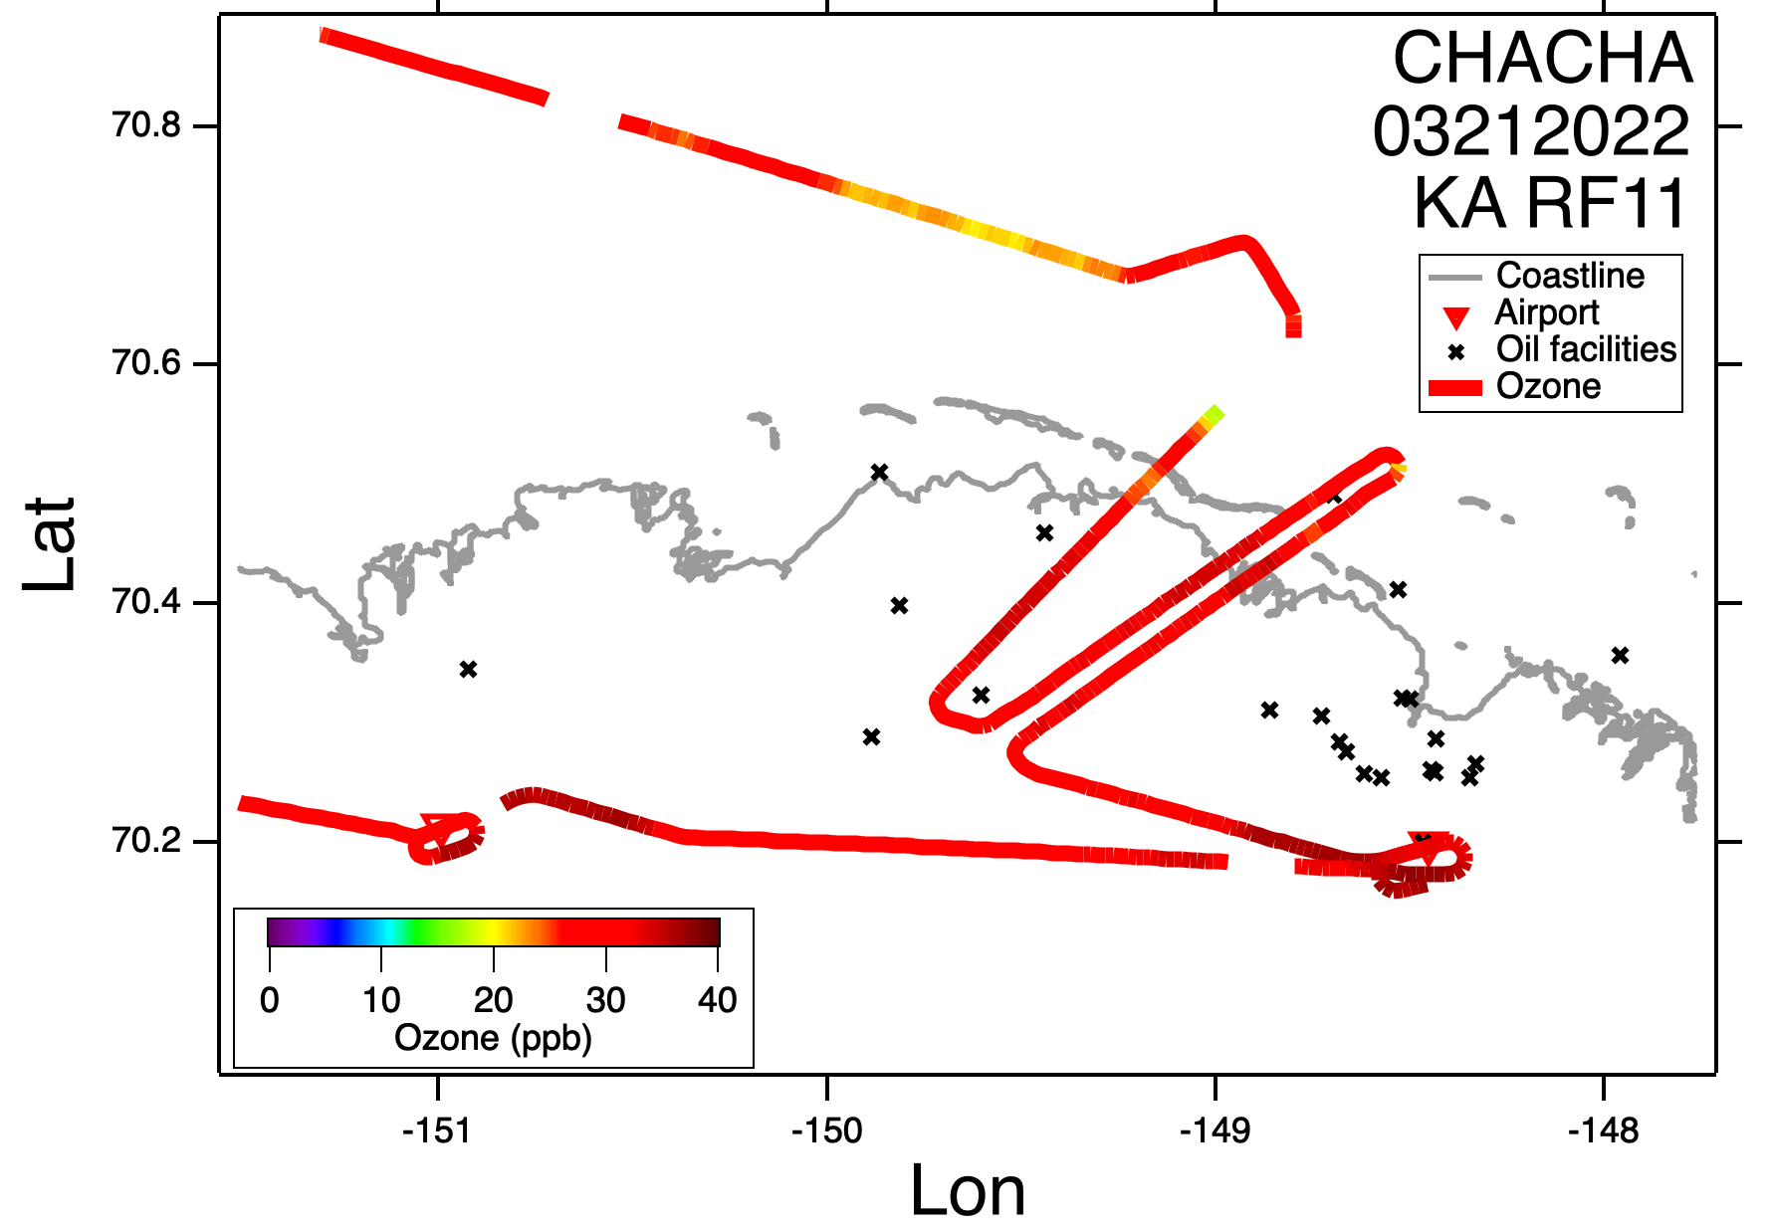
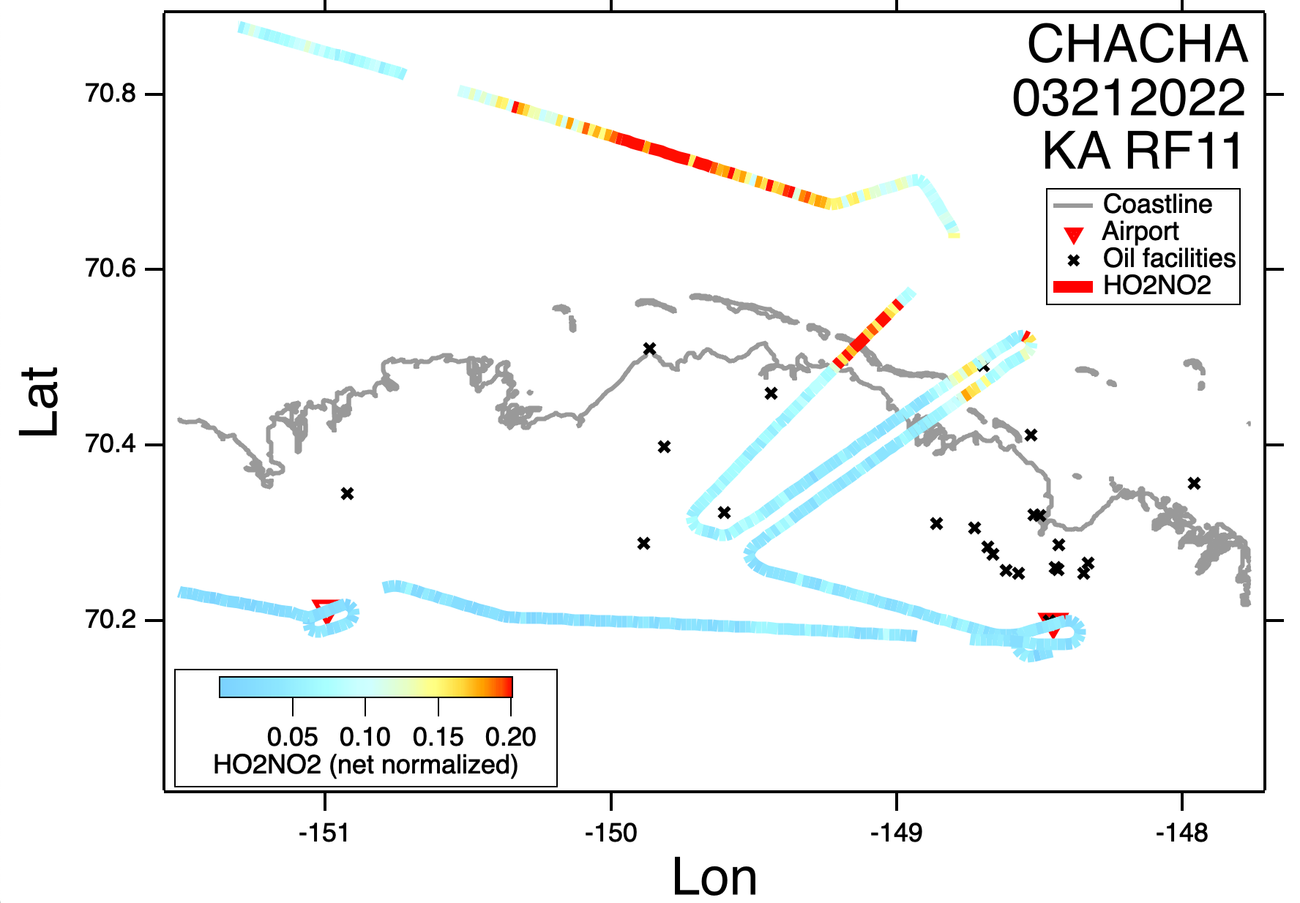
Prudhoe Bay oil field observations
Enhanced levels of Br₂, HO₂NO₂ and HNO₃ downwind of oilfield, corresponding to ozone depletion
Wind
Wind
Wind
Wind
5A.2: Understanding the End of Season Bromine Chemistry in the Arctic Boundary Layer… Next Talk
Daun Jeong

Slide 19
Lead Cloud Flight Planning Considerations
Not many alternate airports to land in
Minimum altitude allowed for cloud penetrations (under Instrument Flight Rules, IFR) is typically 1000ft or higher
Arctic boundary layer in Feb-April is typically below 1000ft
The low boundary layer was a challenge for all boundary layer sampling, but Visual Flight Rules (VFR) have much lower minimum altitudes than IFR.
P4
downwind
The only IFR legs in the flight (~30min total)
In-cloud
P3
P1
P2
Wind
upwind
Notes:
For the pilots to become comfortable flying under these conditions, they needed to fly in the vicinity of these clouds enough to realize that lead clouds are much more optically transparent than typical “cloud” conditions at lower latitudes, on account of their lower liquid water content and droplet number concentrations. Pilots were able to get much lower into “sea smoke” or “low visibility patches” than into the thicker clouds downwind. We designed flight plans so that the pilots would start off getting a close up view of the clouds before entering themThis turned out to be a winning strategy, later in the project. If the pilots were not comfortable flying into the clouds because the clouds were too thick and low, we would at least get the upwind aerosol measurements (and potentially also the downwind aerosol measurements) in addition to the 3-dimensional thermodynamic structure of the clouds from the dropsonde data.

Slide 20
In-situ Cloud and Aerosol Microphysics Observations
Wind
Aerosol & Cloud
Notes:
, spiraling up near the clouds to assess cloud top height and thickness, then flying over the clouds to drop sondes through them at the leading edge and further downwind, then dipping down into the clouds once they had assessed the clouds from multiple different angles.

Slide 21
In-situ Cloud and Aerosol Microphysics Observations
Wind
upwind
Above-cloud
In-cloud
Aerosol & Cloud

Slide 22
In-situ Cloud and Aerosol Microphysics Observations
Wind
upwind
Above-cloud
In-cloud
On CVI
Aerosol & Cloud
“Sea-smoke”

Slide 23
In-situ Cloud and Aerosol Microphysics Observations
Wind
upwind
Above-cloud
In-cloud
Dropsonde launches
On CVI
Aerosol & Cloud
“Sea-smoke”

Slide 24
Wind
Readying a dropsonde
Jose Fuentes
14B.2 - Atmospheric Boundary Layer characteristics over the Coastal Alaskan North Slope during spring 2022 (Invited)
11:00-11:15 AM
Thursday (Room 504)
38 dropsondes in total
Notes:
The impact of open leads on the boundary layer structure was investigated using dropsondes, as further discussed in Jose Fuentes talk 14B.2 on Thursday at 11am in room 504. An example is shown here with the upwind side of the

Slide 25
The CHACHA dataset will be used with Lagrangian chemical box modeling and cloud parcel modeling to better constrain the importance of cloud processing on Arctic halogen chemistry and associated aerosol formation.
Photo Credit: Sarah Woods

Slide 26
The CHACHA dataset will be used with Lagrangian chemical box modeling and cloud parcel modeling to better constrain the importance of cloud processing on Arctic halogen chemistry and associated aerosol formation.
First, offline chemical analysis of PILS, DRUM and snow samples by (Ion chromatography coupled with inductively coupled plasma mass spectrometry and CCSEM-EDX) need to be conducted.
DRUM samples
UMichigan and UAlbany are recruiting students and postdocs to analyze samples, interpret data, and conduct 3D photochemical models! Talk with me or email me at smlance@albany.edu for more info.
PILS samples
Photo Credit: Sarah Woods

Slide 27
Outreach efforts
Photo Credit: Sarah Woods
As part of the Broader Impacts work for CHACHA video interviews of some of the CHACHA participants can be seen at www.arcticstories.net. Updates coming.
Photo Credit: Aaron Wang
Photo Credit: Sarah Woods
Photo Credit: Natasha Garner
Photo Credit: Katja Bigge
Notes:
Measurement availability. Invite to Collaborate with us

Slide 28
Acknowledgements
CHACHA was supported by the National Science Foundation Atmospheric Chemistry Program (AGS) and the Arctic Natural Sciences Program (OPP), and the Arctic Research Support and Logistics Program (OPP), for which we are grateful. (Grant #A52P-1191)
The CHACHA field campaign was made possible in part with the exceptional support of the University of Wyoming faculty, staff, pilots, and crew of the Wyoming King Air. Special thanks to pilot Tom Drew for flying the majority of the lead cloud flights.
Field operations were very well supported by Raelene Wentz and Cody Johnson of UIC-Science. We couldn't have done it without you!
Photo Credit: Chris Rodgers

